Slide 1

Notes:
Welcome to the SkyTech Academy Rope Access Training Curriculum. This is the instructor-ready teaching deck for our SPRAT Level 1–3 certification courses. It is built from our curriculum manual and the Day 1–4 training program, reorganized into a logical teaching order and substantially expanded: every technique now carries the why, the failure modes, and what the evaluator is watching for. Instructors: the speaker notes on each slide are your teaching script — including the questions students most often ask at that point in the course.

Slide 2
PROGRAM ARCHITECTURE
How the Five-Day Curriculum Works
DAY 01
DAY 02
DAY 03
DAY 04
DAY 05
Foundations
Core Techniques
Rigging & Rescue
Advanced & Consolidation
Assessment
— Orientation
— JSA
— equipment
— redundancy
— knots
— basic movement
— Regulations
— fall protection
— SPRAT certification & grading
— knot passing
— deviations
— re-anchors
— transfers
— Anchors
— load physics
— hauling / lowering
— rescue progressions
— L2 / L3 rigging
— complex rescue
— scenarios
— mock evaluation
— Theory checks
— practical assessment
— debrief
— next-step development
SKYTECH ACADEMY
PROGRAM ARCHITECTURE
2
Notes:
This deck teaches a full five-day SPRAT-aligned course. The architecture builds in five phases: Day 1 foundations, Day 2 core techniques, Day 3 rigging and rescue, Day 4 advanced work and consolidation, Day 5 assessment. Each phase depends on the one before — you cannot rig safely without load theory, and you cannot rescue without core movement. Walk the class through the arc so they see where every day is heading.
Sources: SkyTech course plan; SPRAT Rope Access Certification Requirements (CRC-01, v25A, Jan 2025) §3.2.

Slide 3
PROGRAM ARCHITECTURE
Every Day Follows the Same Learning Rhythm
07:30–08:00
Start-Up
Check-in · equipment readiness · JSA / hazard review
08:00–10:00
Classroom
1–2 hr guided discussion: what / how · why · when · failures · evaluator · Q&A
10:15–12:00
Demonstration
Instructor models the day’s techniques and decision-making
12:45–15:30
Practice
Progressive coached stations; repetition until safe and controlled
15:45–16:45
Consolidation
Rescue / scenario work, remediation and evaluation-style practice
16:45–17:00
Debrief
Questions · equipment accountability · next-day preparation
SKYTECH ACADEMY
PROGRAM ARCHITECTURE
3
Notes:
Every training day follows the same rhythm so trainees always know what comes next: start-up and JSA, one to two hours of guided classroom discussion, an instructor demonstration, the largest block for coached practice, a consolidation block for rescue and scenario work, and a debrief. Protect the classroom hour — it is where the why lives — but the bulk of the day is hands-on repetition. This predictable structure lowers anxiety and builds professional site habits.
Sources: SkyTech course plan.

Slide 4
TRAINING PHILOSOPHY
Safety Through Competence
"We prepare technicians not just to pass their certification, but to perform confidently and safely in real industrial environments across Houston's petrochemical, oil & gas, construction, and wind energy sectors."
Safety First
Competency-Based
Field-Realistic
Work-Ready
The training environment is treated as a real worksite — daily JSA, mandatory PPE, zero shortcuts.
We certify demonstrated skill against objective criteria — not hours spent in a seat.
Simulations mirror refinery, tower and offshore conditions students will actually face.
Graduates leave able to perform the work — and to be productive from day one.
SKYTECH ACADEMY
TRAINING PHILOSOPHY
4
Notes:
Training philosophy — the standard behind the whole course. We prepare technicians not just to pass their certification, but to perform confidently and safely in real industrial environments across Houston's petrochemical, oil & gas, construction and wind energy sectors. Four commitments define it: safety first (the training environment is a real worksite — daily JSA, mandatory PPE, zero shortcuts), competency-based (we certify demonstrated skill against objective criteria, not seat time), field-realistic (simulations mirror the refinery, tower and offshore conditions students will actually face), and work-ready (graduates leave able to perform the work and be productive from day one).
Sources: SkyTech Academy.

Slide 5
INDUSTRY OVERVIEW
Inspection, Maintenance & Market Opportunity
Petrochemical
Infrastructure
Telecom & Towers
Commercial
Tanks, stacks, columns & vessels — continuous turnaround cycles.
Bridges, dams & transport structures requiring periodic inspection.
Communication masts & high structures needing at-height service.
Stadiums, high-rise façades & large venues across the region.
Every sector needs a steady supply of certified technicians — and every certification expires and must be renewed.
3 yr
L1–L3
Recurring
SPRAT cert cycle
SPRAT levels
Refresher demand
SKYTECH ACADEMY
INDUSTRY OVERVIEW
5
Notes:
Context slide: why this training pipeline exists. Rope access serves petrochemical, infrastructure, telecom and commercial sectors — all requiring recurring at-height inspection and maintenance. The business driver for trainees to understand: every sector needs a steady supply of certified technicians, and every certification expires and must be renewed — SPRAT on a 3-year cycle — creating recurring, durable demand for the skills they are learning.
Sources: SPRAT Rope Access Certification Requirements (CRC-01, v25A, Jan 2025) §2.3.

Slide 6
WHY ROPE ACCESS
Cost Savings & Productivity
WHERE THE SAVINGS COME FROM
62%
▼
Reduced material costs
No scaffold tubes, boards, or fittings to buy, transport and store.
lower total project cost
Documented industrial refinery study, rope access vs. scaffolding for the same scope of work.
Smaller, skilled teams
▼
A handful of certified technicians replace large scaffolding crews.
Faster mobilization also means less plant downtime — often worth more than the labor savings alone.
▼
Faster mobilization
Setup in hours, not days — work starts and finishes sooner.
▼
Lower exposure hours
Fewer total worker-hours at height reduces risk and overhead.
SKYTECH ACADEMY
WHY ROPE ACCESS
6
Notes:
Cost and productivity context: the economic case that puts rope access on the worksite. A documented industrial refinery study found up to 62% lower total project cost versus scaffolding for the same scope. The savings come from four places — reduced material costs, smaller skilled teams, faster mobilization, and lower total exposure hours. Just as important, faster mobilization means less plant downtime, which for a refinery or platform can be worth more than the labor savings alone.
Sources: SOURCE NEEDED.
SOURCE NEEDED: the 62% cost figure and refinery case study have no citation. Confirm the study or remove the figure before delivery.

Slide 7
WHY ROPE ACCESS
Real-World Applications
Rope access is the access method — professional competence comes from combining it with a trade discipline.
CASE STUDY
Refinery Turnaround
Inspection & NDT
Maintenance
Visual, ultrasonic & non-destructive testing of assets at height.
Mechanical & structural maintenance in hard-to-reach locations.
Rope access crews completed inspection & maintenance scopes in a fraction of the time and cost of scaffold-based access — returning the unit to production faster.
Construction & Install
Coating & Blasting
Installation and assembly tasks on complex structures.
Surface preparation, painting & protective coating support.
62%
Hours
lower cost
to mobilize
SKYTECH ACADEMY
WHY ROPE ACCESS
7
Notes:
Real-world application context: rope access is the access method — professional competence comes from combining it with a trade discipline: inspection and NDT, maintenance, construction and installation, or coating and blasting. The case study makes it concrete: on a refinery turnaround, rope access crews completed inspection and maintenance scopes in a fraction of the time and cost of scaffold-based access, returning the unit to production faster — roughly 62% lower cost and mobilization measured in hours.
Sources: SOURCE NEEDED.
SOURCE NEEDED: the 62% cost figure and refinery case study have no citation. Confirm the study or remove the figure before delivery.

Slide 8
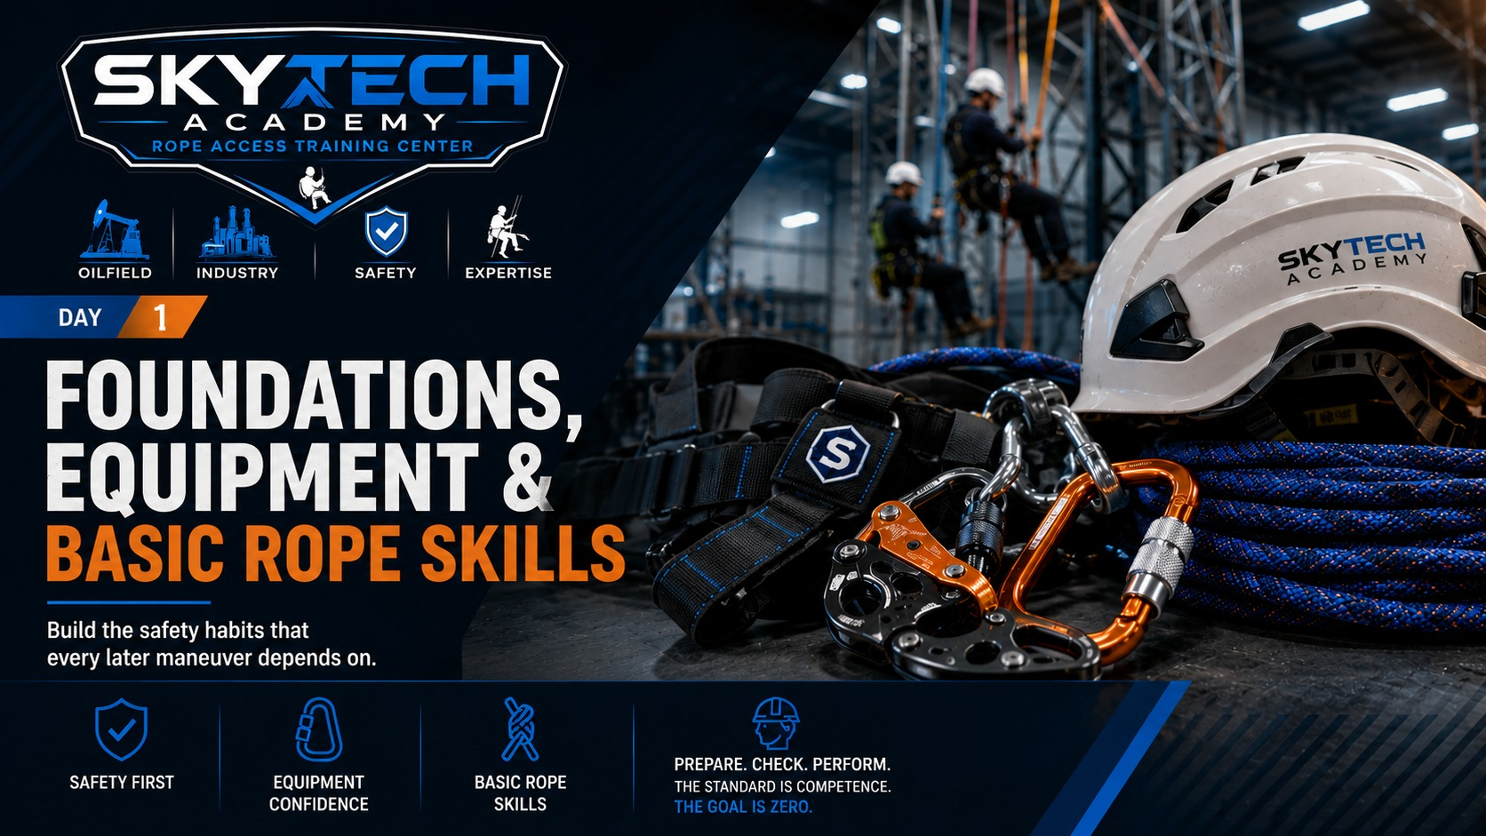
Notes:
Day start-off slide. Set the theme for the day and run the morning JSA before any practical activity.

Slide 9
DAY 1 · CLASSROOM
1–2 Hour Classroom — Foundations, Equipment & Basic Rope Skills
01
Course orientation & JSA
DISCUSS Who can stop the work — and when?
02
Rope-access foundations
DISCUSS What fails if one rope is cut?
03
Harness, connectors & devices
DISCUSS Which harness point is for what?
04
Inspection, kitting & buddy checks
DISCUSS What takes gear out of service?
05
Knots & terminations
DISCUSS Which knot for which function?
06
Basic ascent, descent & changeover
DISCUSS What holds you during a changeover?
INSTRUCTOR NOTE
Do not rush the classroom portion. Use trainee questions and site examples to connect each concept to the practical stations that follow.
SKYTECH ACADEMY
DAY 1 · AGENDA
9
Notes:
Day 1 classroom agenda. Six 15–20 minute discussion blocks, each linked to a demonstration and practical station. The instructor note is important: the classroom hour is not filler — it is where hazard recognition and the why are built before anyone is exposed on rope.
Sources: SPRAT Rope Access Certification Requirements (CRC-01, v25A, Jan 2025) §3.2, §6.

Slide 10
INSTRUCTOR DISCUSSION
DAY 1
Course Orientation & JSA
WHAT / HOW
WHY
WHEN / WHEN NOT
Start the course correctly
The classroom comes first
Use it every training day
Confirm paperwork, training-bay rules, stop-work authority, exclusion zones and the day’s Job Safety Analysis before any practical activity. Walk the exclusion-zone boundary physically and confirm every trainee has signed and dated the JSA.
Rope-access competence starts with hazard recognition and planning — not with getting on rope. The JSA gives the team a shared mental model before exposure. Most incidents trace to a hazard spotted too late — the JSA moves that recognition to before anyone is on rope.
Review hazards whenever tasks, equipment, weather, personnel or rigging change. Never treat the JSA as a one-time signature exercise. Re-brief after every break and any time the crew composition changes.
WHAT GOES WRONG
EVALUATOR'S EYE
TRAINEE Q&A
Paperwork without understanding
What to observe
“What if I see something unsafe after we signed?”
Trainees sign without participating, miss changed hazards, or assume the instructor owns all safety decisions. A signature without participation is the most common paperwork failure on real sites.
Can the trainee identify hazards, controls and stop-work triggers in their own words before approaching the system? Listen for specific named hazards and controls — not vague answers like “be careful.”
Stop the activity, make the area safe, update the JSA / control plan and communicate the change before restarting. Stop-work authority belongs to everyone, including the newest trainee.
SKYTECH ACADEMY
DAY 1
10
Notes:
Orientation and JSA. Confirm all paperwork, bay rules, stop-work authority and exclusion zones, then run the Job Safety Analysis. Teach the JSA as a living document reviewed whenever conditions change — signing means you read and understood it. The stop-work answer is the key takeaway: anyone can stop the job, make it safe, update the plan, then restart.
Sources: SPRAT Safe Practices for Rope Access Work; employer JSA procedure.

Slide 11
INSTRUCTOR DISCUSSION
DAY 1
Rope-Access Foundations
WHAT / HOW
WHY
WHEN / WHEN NOT
Three operating principles
Why redundancy matters
Every maneuver, every transition
Teach redundancy, continuous 100% protection during transitions, and controlled movement. Have trainees identify the working system and the independent backup at each step. Redundancy, continuous 100% attachment and control are the three principles every later maneuver is built on.
The system is designed so one foreseeable failure does not automatically become a fall. Redundancy only works when the backup is truly independent and correctly managed. Independent means a separate rope, separate anchor and separate attachment — no shared failure point.
Apply before releasing any connection, during transfers, obstacle passage, rescues and edge transitions. Never trade redundancy for speed. Apply the one-rope test constantly: if cutting one line would drop you, the system is wrong.
WHAT GOES WRONG
EVALUATOR'S EYE
TRAINEE Q&A
Single-point moments
Evaluator focus
“Can I disconnect briefly if I’m holding on?”
Disconnecting too early, both systems sharing a common weak point, slack backups and uncontrolled loading. Each of these is automatic-failure territory on assessment day.
The trainee maintains protection without prompting and recognizes when a proposed sequence creates a single-point failure.
No. Hand strength or body position is never a substitute for the required protection system. Grip fails first in a fall or a faint — the system must hold without you.
SKYTECH ACADEMY
DAY 1
11
Notes:
The three operating principles — redundancy, continuous 100% protection, and controlled movement — are the DNA of every technique in the course. Have trainees name the working system and independent backup at every step. The one-rope test: if cutting one line would drop the technician, the system is wrong. Hand strength is never protection.
Sources: SPRAT Rope Access Certification Requirements (CRC-01, v25A, Jan 2025) §4.2.3–4.2.4, §4.3.5.

Slide 12
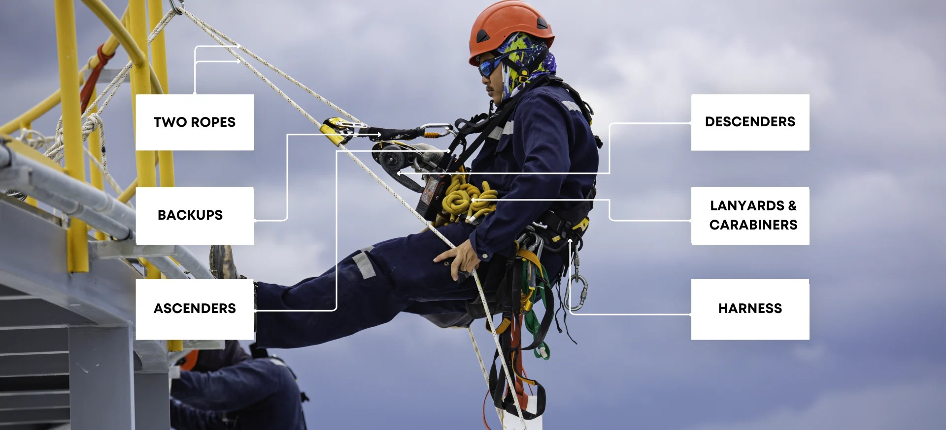
DAY 1 · SEE IT
The Rope Access System at a Glance
Two independent ropes, always. A working line carries the technician; a separate backup line with its own device catches a failure.
SKYTECH ACADEMY
SEE IT · THE ROPE ACCESS SYSTEM
12
Notes:
Use this photo before any equipment detail. Point to each label: two ropes (working + backup), backup device, ascenders, descender, lanyards and carabiners, harness. Ask: which part catches you if the working line fails? Image source: supplied by SkyTech — confirm usage rights before external distribution.

Slide 13
INSTRUCTOR DISCUSSION
DAY 1
Harness, Connectors & Devices
WHAT / HOW
WHY
WHEN / WHEN NOT
Know the specific equipment
Why generic rules are dangerous
Use only as designed
Identify harness attachment points, connectors, descenders, ascenders and backup devices. Teach use according to markings and manufacturer instructions. Cover the ventral, sternal, dorsal and lateral points and what each is rated and intended to do.
Attachment-point ratings, device compatibility and user ranges vary by model and standard. Correct identification prevents misloading and incompatible combinations. Rope diameter, connector shape and device model must all be verified as a compatible set.
Match each device and attachment point to its intended function. Do not improvise uses because a component “looks strong enough.” Dorsal is fall-arrest only; ventral and sternal carry the working rope-access load.
WHAT GOES WRONG
EVALUATOR'S EYE
TRAINEE Q&A
Misorientation & incompatibility
Evaluator focus
“Are all harness D-rings the same strength / use?”
Cross-loaded connectors, unlocked gates, reversed devices, incorrect rope diameter and wrong attachment points can defeat the system. Cross-loading a carabiner across its minor axis can cut its strength by more than half.
Correct selection, orientation, locking, rope path, function check and self / buddy verification. Gates locked, devices correctly oriented, and rope threaded the correct way through each one.
No. Use the harness markings and manufacturer instructions; never assume identical function or rating. Lateral D-rings are used as a pair for positioning, never singly.
SKYTECH ACADEMY
DAY 1
13
Notes:
Equipment identification. Each attachment point and device has a specific function, rating and user range — teach to the markings and manufacturer instructions, not to generic rules. Ventral for positioning, sternal for backup and chest ascender, dorsal for fall arrest only, laterals in pairs. Cross-loading, unlocked gates and wrong rope diameter are the classic defeats.
Sources: Manufacturer instructions; ANSI/ASSP Z359.11; SPRAT Rope Access Certification Requirements (CRC-01, v25A, Jan 2025) §4.3.4.

Slide 14
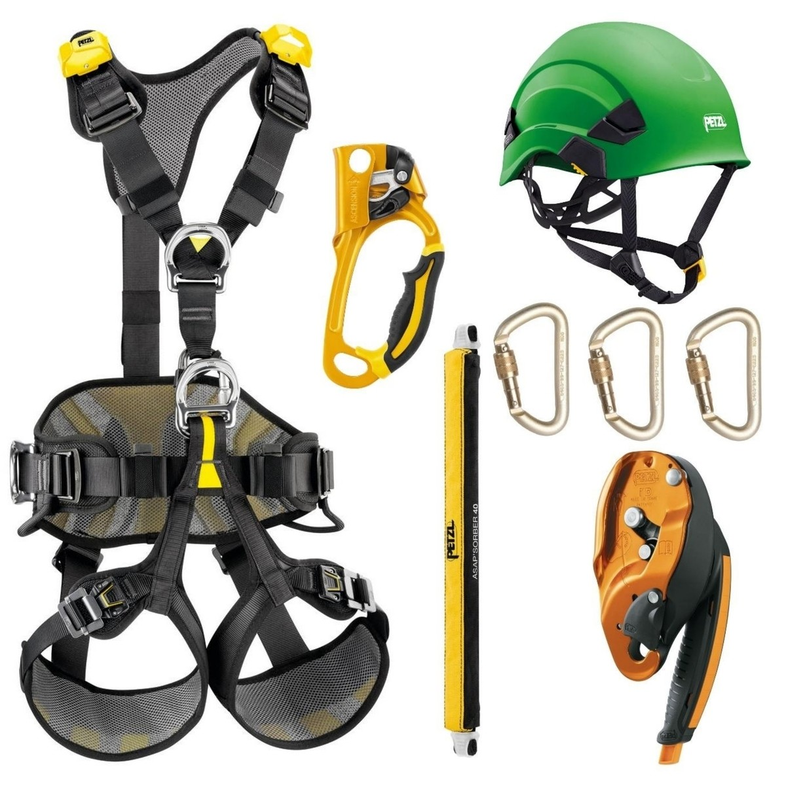
DAY 1 · EQUIPMENT
Personal Rope Access Kit — What Each Item Does
YOUR PERSONAL KIT — SIX CORE ITEMS
1
Full-body harness
Ventral, sternal, dorsal and lateral attachment points
2
Hand ascender
Grips the working line going up — never alone as backup
3
Helmet with chinstrap
Chinstrap fastened in the fall zone
4
Energy-absorbing lanyard
Connects the backup device; limits arrest force
5
Locking connectors
Screw-gate or auto-lock; gate closed and locked
6
Descender
Auto-locking, with panic function where fitted
Example equipment shown. Use the makes and models listed in SkyTech’s kit register.
SKYTECH ACADEMY
EQUIPMENT · PERSONAL KIT
14
Notes:
Walk through each numbered item, then hand the real equipment around. Every item must be within its service life, inspected and logged. Brands shown are examples only; SkyTech kit may differ. Image source: manufacturer product photo supplied by SkyTech — confirm usage rights.

Slide 15
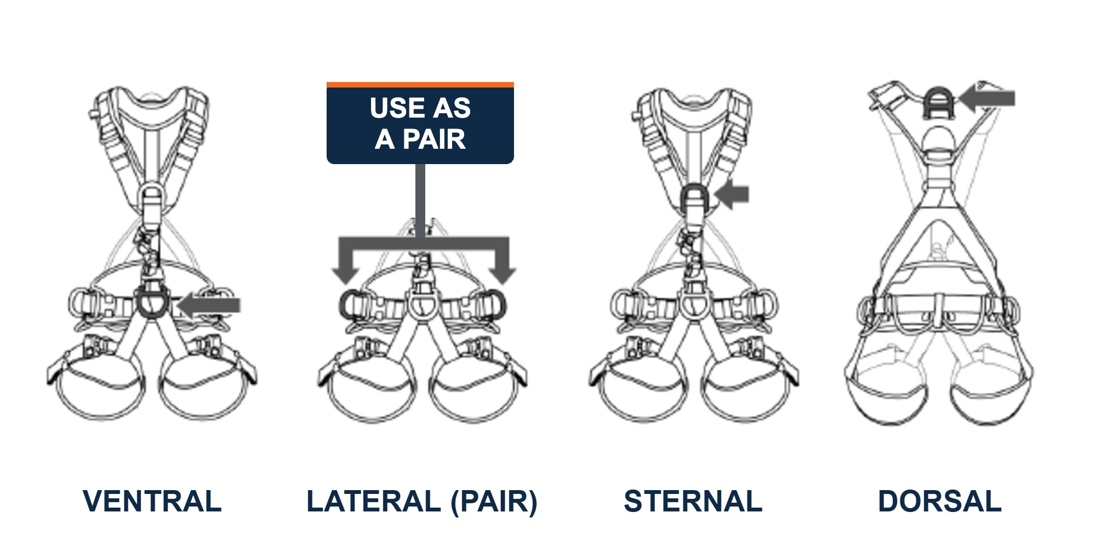
DAY 1 · EQUIPMENT REFERENCE
Harness Attachment Points — Four Points, Four Jobs
POINT
LOCATION
PRIMARY USE
MBS
KEY CHECK
Ventral
Front waist
Rope access / positioning — where you live
5,000 lb
Gate closed and locked
Sternal
Chest
Backup device · chest ascender · limited fall arrest
5,000 lb
Arrest use only if labeled
Dorsal
Between shoulder blades
FALL ARREST ONLY
5,000 lb
Buddy checks it for you
Lateral
Side D-rings
Work positioning — always in pairs
5,000 lb
Clip both rings together
HARDWARE STRENGTH — MINIMUM BREAKING STRENGTH
D-rings 5,000 lb · Buckles & adjusters 4,000 lb
Dorsal fall arrest limits the force on your body to 1,800 lb. Any ring or buckle that has arrested a fall is removed from service.
STUDENT PRACTICE
Point to and name every attachment point on your own harness; state its MBS and its job before you kit up.
SKYTECH ACADEMY
REFERENCE · HARNESS ATTACHMENT POINTS
15
Notes:
Harness attachment points. Hardware minimum breaking strength: D-rings 5,000 lb; buckles and adjusters 4,000 lb (ANSI/ASSP Z359.11). Ventral: main rope-access point, connector gate closed and locked. Sternal: chest ascender; fall arrest only if the harness label allows. Dorsal: fall arrest — the system limits body force to 1,800 lb; you can’t see it, so your buddy checks it. Laterals: work positioning, always both rings together. Confirm every value against your own harness label.
Sources: Harness manufacturer label and instructions; ANSI/ASSP Z359.11; OSHA 29 CFR 1926.502(d)(16).

Slide 16
INSTRUCTOR DISCUSSION
DAY 1
Inspection, Kitting & Buddy Checks
WHAT / HOW
WHY
WHEN / WHEN NOT
Inspect before use
Why two sets of eyes
Before every practical session
Check soft goods, hardware, labels, compatibility and function. Fit the harness, install devices, function-test and complete a second-person buddy check. Inspect soft goods for cuts, abrasion, glazing and chemical damage; hardware for cracks, wear and gate action.
Routine familiarity creates blind spots. A structured buddy check catches mis-threading, unlocked connectors and incorrect device orientation before exposure. Familiarity breeds blind spots — the buddy check catches what your own eyes skip over.
Repeat after equipment changes, breaks, major reconfiguration or whenever there is any doubt. Also re-check after a dropped item or any suspected shock load.
WHAT GOES WRONG
EVALUATOR'S EYE
TRAINEE Q&A
Rushing the check
Evaluator focus
“What if damage is questionable?”
Skipping labels, overlooking glazing / cuts / corrosion, failing to function-test, or assuming yesterday’s setup is still correct. Yesterday’s “good” is not today’s inspection — verify every session from scratch.
A systematic inspection sequence and willingness to quarantine suspect equipment. Willingness to fail a questionable item is graded as professional judgment, not indecision.
Remove it from service and follow the organization / manufacturer inspection process. Never “test it on rope.” Tag it out of service immediately so no one else can pick it up.
SKYTECH ACADEMY
DAY 1
16
Notes:
Inspection and buddy checks. Three layers: pre-use by the user, formal documented inspection by a competent person, and retirement when in doubt. The buddy check exists because your own eyes forgive your own mistakes. When in doubt, out — quarantine suspect gear, never test it on rope.
Sources: Manufacturer inspection instructions; ANSI/ASSP Z359.2.

Slide 17
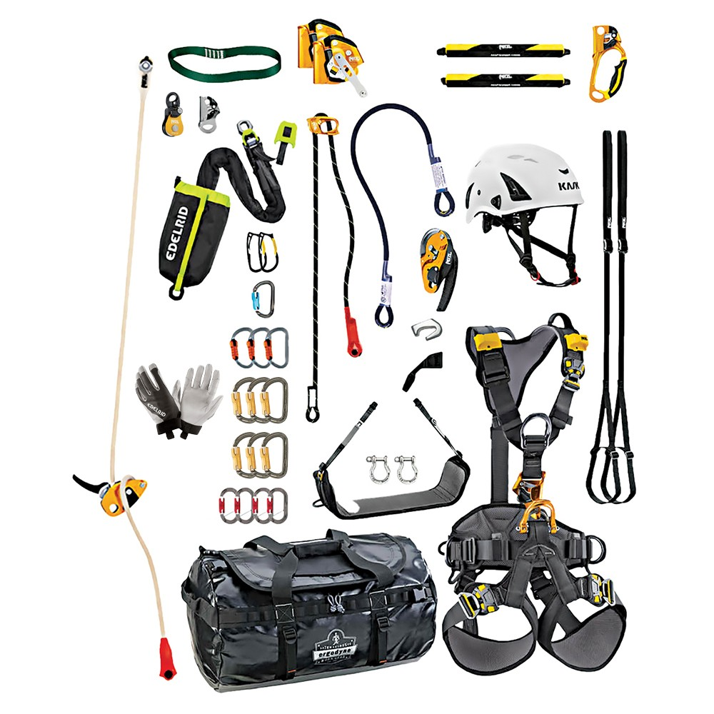
DAY 1 · EQUIPMENT
The Full Kit — Check It Out, Check It Over
KIT-UP CHECKLIST — BEFORE YOU LEAVE THE STORE
Harness + seat board
Fitted, buckles done up
Descender
Correct rope diameter
Helmet
Chinstrap adjusted
Backup device + absorber
Matched as a tested pair
Gloves
Good grip, no holes
Cowstails / lanyards
Stitching and terminations
Chest ascender
Mounted, cam clean
Connectors
Gates close and lock
Hand ascender + foot loop
Length set to your leg
Slings, pulleys, rope bag
Counted and tagged
Buddy check every item before you load a rope.
SKYTECH ACADEMY
EQUIPMENT · KIT-UP CHECKLIST
17
Notes:
Each trainee kits up from the store against this list, then a partner checks every item. Faulty or untagged gear is quarantined, not swapped quietly. Image source: example kit photo supplied by SkyTech — confirm usage rights.

Slide 18
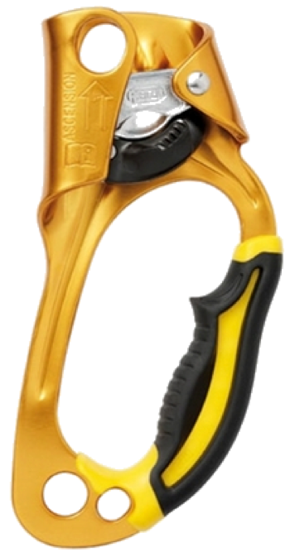
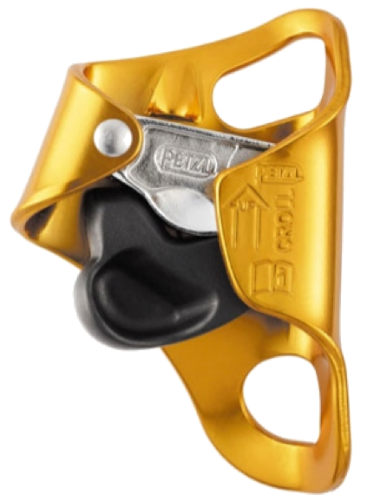
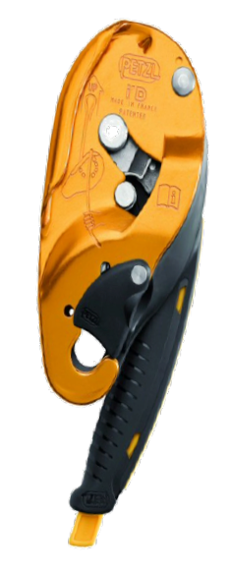
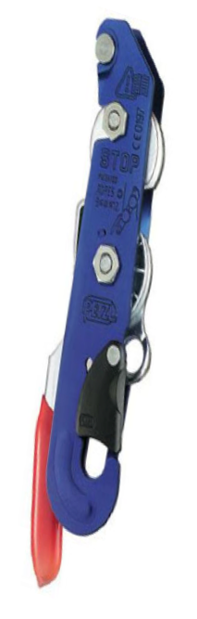
DAY 1 · EQUIPMENT INSPECTION
Inspect Before Use — Ascenders & Descenders
HAND ASCENDER
1 Cam teeth sharp, clean, not worn
2 Safety catch opens fully, snaps back
3 Frame free of cracks, bends, sharp edges
4 Attachment holes not worn or elongated
CHEST ASCENDER
1 Cam springs back and grips the rope
2 Teeth clean — no mud, ice or paint
3 Top and bottom holes not worn sharp
4 Fitted so the rope runs straight up
AUTO-LOCKING DESCENDER
1 Side plate opens, closes and latches
2 Handle returns; anti-panic engages
3 Friction surfaces not deeply grooved
4 Rope path matches the diagram on the device
SIMPLE DESCENDER
1 Side plate and safety catch close fully
2 Handle springs back when released
3 Bollards not deeply grooved or sharp
4 Releasing the handle stops the descent
Function-test at ground level before every climb — load it, release it, and watch it lock.
SKYTECH ACADEMY
DAY 1 · INSPECTION 1 / 3
18
Notes:
Inspection 1 of 3 — ascenders and descenders. For each device, trainees check the four points, then function-test it on a rope at ground level: load, release, confirm it locks. Any doubt means quarantine. Sources: manufacturer instructions for each device; ANSI/ASSP Z359.
Sources: Manufacturer instructions for each device.

Slide 19
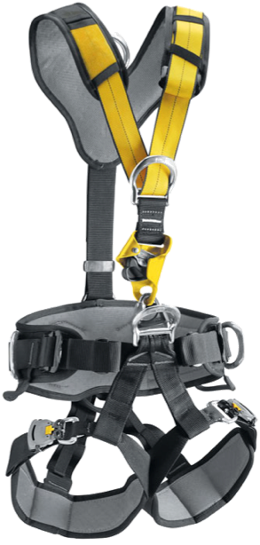
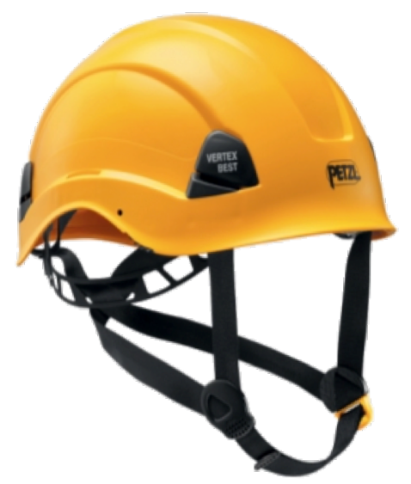
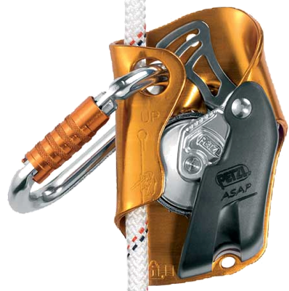
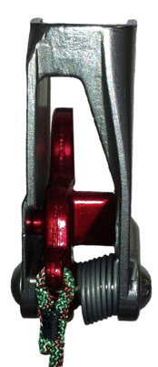
DAY 1 · EQUIPMENT INSPECTION
Inspect Before Use — Harness, Helmet & Backup
HARNESS
1 Webbing: no cuts, burns, fraying or fading
2 Stitching intact — no pulled threads
3 Buckles lock; D-rings not bent or corroded
4 Label legible and within its lifespan
HELMET
1 Shell: no cracks, dents or deep gouges
2 Chinstrap and buckle hold firm
3 Headband and clips intact, adjust easily
4 Retire after any heavy impact
BACKUP DEVICE
1 Runs freely up and down the rope
2 Locks at once when jerked downward
3 Connector captive, gate locked
4 Fitted the right way up — arrow up
ROPE GRAB
1 Cam moves freely; spring returns
2 Grips when loaded, releases cleanly
3 Axle and side plate secure
4 No cracks, bends or heavy wear
Retire it after a fall arrest, at the end of its marked lifespan, or whenever you are in doubt.
SKYTECH ACADEMY
DAY 1 · INSPECTION 2 / 3
19
Notes:
Inspection 2 of 3 — harness, helmet and backup. The harness and helmet are soft goods and plastics: check age, UV damage and chemical contact as well as visible damage. The backup device must lock instantly — do a sharp downward jerk test before every use. Sources: manufacturer instructions; ANSI/ASSP Z359.11 (harness).
Sources: Manufacturer instructions for each device.

Slide 20
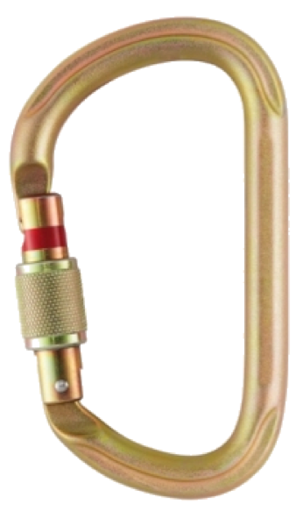
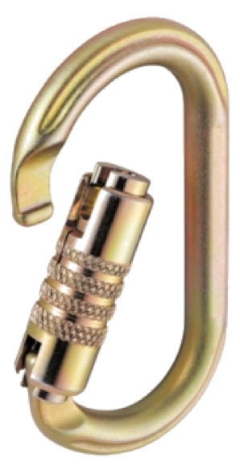
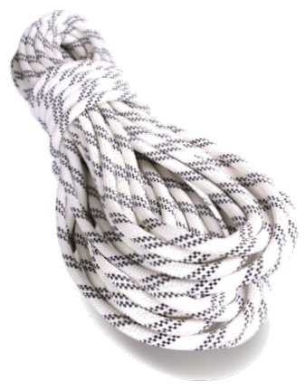
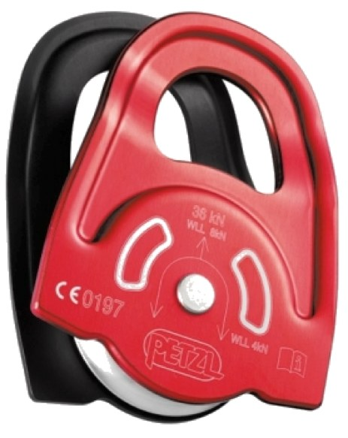
DAY 1 · EQUIPMENT INSPECTION
Inspect Before Use — Connectors, Rope & Pulleys
SCREWGATE CONNECTOR
1 Gate opens, closes and latches fully
2 Sleeve screws fully shut, no binding
3 No cracks, sharp edges or deep grooves
4 Loaded along the spine, never the gate
AUTO-LOCKING CONNECTOR
1 Gate locks by itself on release
2 Springs shut without sticking
3 Steel body free of rust and bends
4 Never cross-loaded over an edge
ROPE
1 Sheath: cuts, abrasion, glazing
2 Core: flat spots, lumps, stiffness
3 No chemicals, paint or stains
4 Ends and knots sound; logbook updated
PULLEY
1 Sheave turns freely, no wobble
2 Side plates straight, open and close
3 Sheave groove smooth, not worn
4 Rated loads marked and legible
Any doubt? Tag it out of service and follow the manufacturer’s inspection instructions.
SKYTECH ACADEMY
DAY 1 · INSPECTION 3 / 3
20
Notes:
Inspection 3 of 3 — connectors, rope and pulleys. Connectors: gate action and locking are the critical checks. Rope: run the full length through your hands, feeling for core damage, and record inspections in the rope log. Sources: manufacturer instructions; ANSI/ASSP Z359.12 (connectors).
Sources: Manufacturer instructions for each device.

Slide 21
INSTRUCTOR DISCUSSION
DAY 1
Knots & Terminations
WHAT / HOW
WHY
WHEN / WHEN NOT
Build, dress, set, inspect
Why knot quality matters
Select by function
Practice the figure-eight family, figure nine, alpine butterfly, stopper / barrel, clove hitch, double fisherman’s and friction hitches as required by the course. For each, teach the correct application, how to dress it and how to inspect it at a glance.
A correctly selected knot can still be unsafe if poorly dressed, inadequately tailed, loaded incorrectly or used for the wrong purpose. A poorly dressed knot can lose a large fraction of the rope’s strength.
Use knots only where appropriate for attachment, isolation, termination, joining or rigging. Consider load direction and whether it must be untied after loading. Match the knot to the function — not to habit.
WHAT GOES WRONG
EVALUATOR'S EYE
TRAINEE Q&A
Wrong knot / poor dressing
Evaluator focus
“Which knot is strongest?”
Crossed strands, short tails, incorrect orientation and unverified knots are recurring errors. A missing stopper knot in a rope end is an instant assessment write-up.
Selection, dressing, setting, adequate tails, correct loading and an independent partner check. Tail length of roughly a fist-width is checked on every knot.
The better question: which approved knot correctly performs the required function in this system. There is no single “strongest” knot — only the right knot, correctly tied, for the job.
SKYTECH ACADEMY
DAY 1
21
Notes:
Knots. Build, dress, set, inspect — a knot is the one piece of equipment you manufacture on site every time. Teach selection by function over a
Sources: SPRAT Rope Access Certification Requirements (CRC-01, v25A, Jan 2025) §6.9.

Slide 22
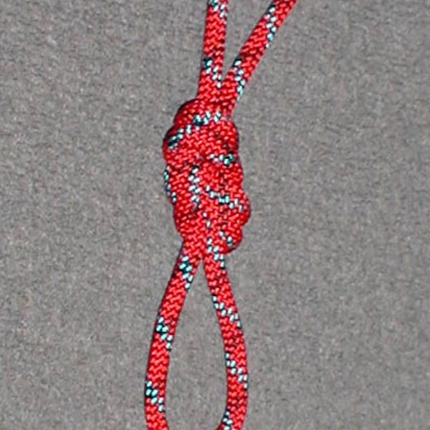
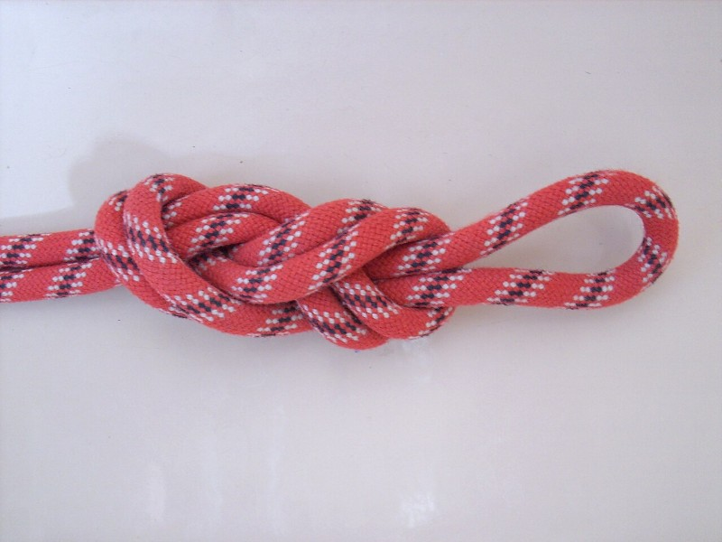
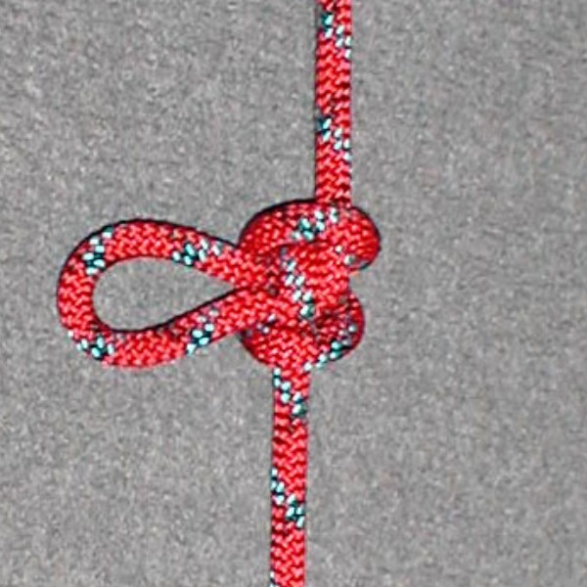
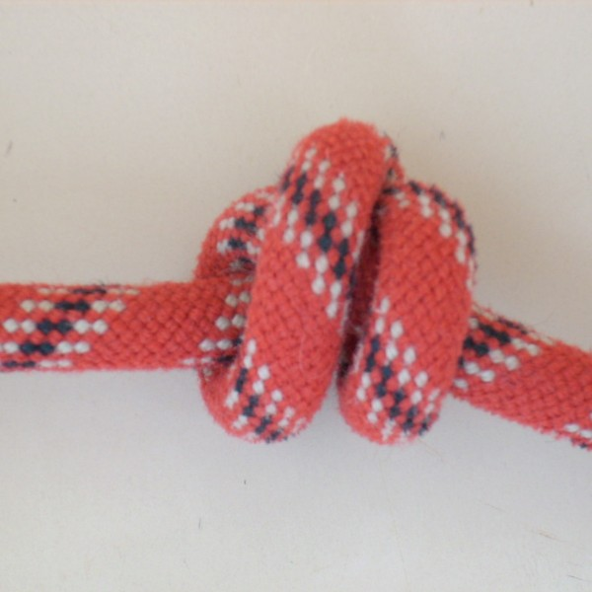
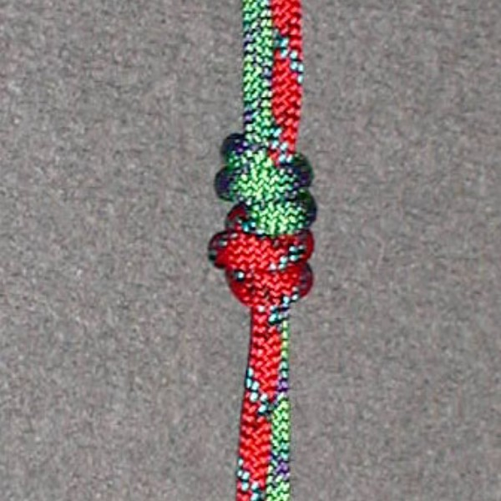
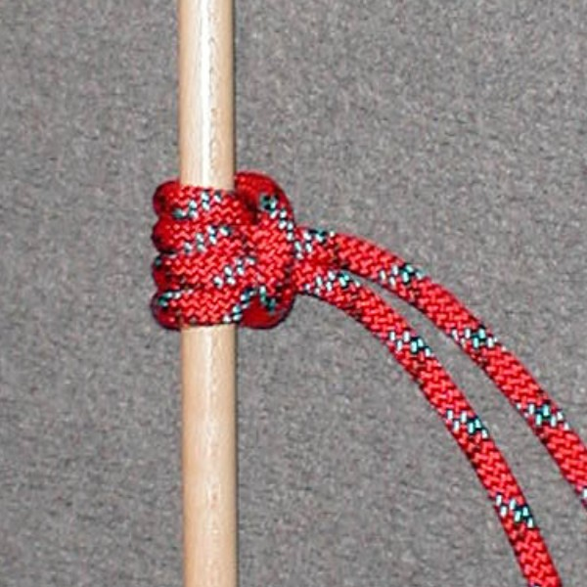
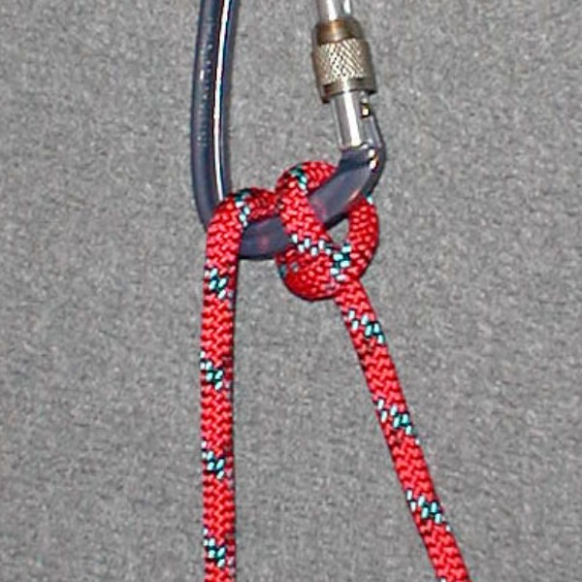
DAY 1 · KNOTS VISUAL GUIDE
Seven Course Knots — What Each One Looks Like
Figure 8 SPRAT L1
Default attachment & anchor — checkable at a glance
Figure 9 SPRAT L1
Sustained anchor load — keeps more strength, unties easier
Alpine Butterfly SPRAT L1
Mid-line attachment; loads 3 ways; isolates damage
Stopper SPRAT L1
Closes the rope end — can’t descend off a closed rope
Double Fisherman’s SPRAT L1
Connects two ropes for retrievable rigging
Prusik COURSE SKILL
Friction hitch — not a SPRAT test item
Munter COURSE SKILL
Belay / lower on a carabiner
DRESSING STANDARD
Correctly formed · dressed flat · set snug · fist-width tail.
COMMON MISTAKES
Crossed strands · short tail · wrong knot for the load · missing stopper knot.
Every knot reduces rope strength — how much depends on the knot, rope and dressing.
INSTRUCTOR CHECKPOINT SPRAT L1 tests four functions: termination, middle, stop and join. Each trainee ties, dresses and sets every knot and passes a partner check.
Photos via Wikimedia Commons: WikipedianYknOK (CC BY-SA 3.0) — figure 8, alpine butterfly, double fisherman’s, prusik, munter; Markus Bärlocher (public domain) — figure 9, stopper.
SKYTECH ACADEMY
DAY 1 · KNOTS
22
Notes:
Photo guide for the seven knots. The drawings show the shape of each knot. Tie each one in front of the class on real rope, and have trainees compare their own knot to the drawing and to your demo before the partner check. Reference to pair with the knots discussion. SPRAT Level 1 tests four knot functions: termination (figure 8, figure 9), middle (alpine butterfly), stop (stopper/barrel) and join (double fisherman’s). The Prusik and Munter are SkyTech course skills, not SPRAT test items. Every knot reduces rope strength; how much depends on the knot, rope and dressing — use manufacturer data, not a single percentage.
Sources: SPRAT Rope Access Certification Requirements (CRC-01, v25A, Jan 2025) §6.9.

Slide 23
INSTRUCTOR DISCUSSION
DAY 1
Basic Ascent, Descent & Changeover
WHAT / HOW
WHY
WHEN / WHEN NOT
Move deliberately
Why sequence matters
Master before obstacles
Teach efficient ascent, controlled descent, backup management and ascent-to-descent changeovers while maintaining continuous protection. Efficient ascent drives from the legs in the footloop; the arms only guide, never haul.
Device order controls whether the trainee remains supported and protected throughout the transition. Load and check the next device before releasing the current one — every changeover, every time.
Trainees should be stable with basic movement before deviations, re-belays, transfers or rescue tasks. Fluency here is the gate to Day 2’s obstacle work.
WHAT GOES WRONG
EVALUATOR'S EYE
TRAINEE Q&A
Uncontrolled movement
Evaluator focus
“Should I memorize hand movements?”
Poor brake-hand discipline, unmanaged slack, releasing a device too early, or loading the wrong system. Hauling with the arms instead of standing in the footloop causes premature exhaustion.
Smooth sequencing, independent backup, controlled body position and the ability to stop safely at any point. Backup kept high and no slack in the system are watched on every meter of rope.
Learn the sequence and the reason behind it. You must be able to adapt while preserving the safety principles. You should also be able to reverse a changeover mid-sequence if something feels wrong.
SKYTECH ACADEMY
DAY 1
23
Notes:
Basic movement. Efficient ascent (stand in the footloop, legs not arms), controlled descent with brake-hand discipline, and the changeover — where device order determines whether you stay supported. Master this before any obstacle work. The evaluator wants smooth sequencing and the ability to stop safely at any point.
Sources: SPRAT Rope Access Certification Requirements (CRC-01, v25A, Jan 2025) §6.2.

Slide 24
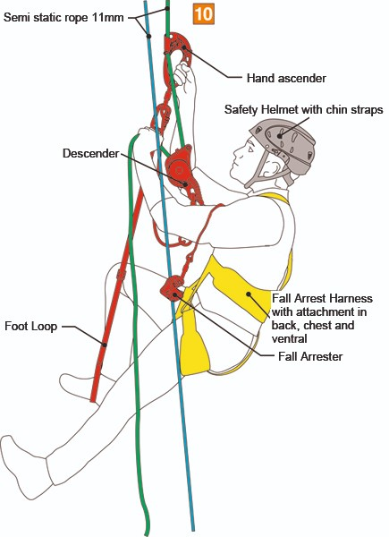
DAY 1 · SEE IT
Ascent Set-Up — Where Every Device Goes
ASCENT SET-UP — CHECK TOP TO BOTTOM
1
Two ropes
Working line and a separate backup line, each on its own anchor
2
Hand ascender + foot loop
Stand up in the foot loop, slide the hand ascender up
3
Chest ascender
On the working line; takes your weight as you sit back
4
Descender
Stays on the working line, ready to change over
5
Backup device
On the backup line, kept above your attachment point
6
Helmet and harness
Chinstrap on; every connector locked
Before leaving the ground: self-check, buddy check, then a test load close to the ground.
SKYTECH ACADEMY
SEE IT · ASCENT SET-UP
24
Notes:
Use the diagram to name each device and its rope before trainees kit up for ascent. Stress that the backup device stays high, and that the descender stays on the working line ready for a changeover. Diagram labels use European terms (fall arrester = backup device). Image source: diagram supplied by SkyTech — confirm usage rights.

Slide 25
INSTRUCTOR DISCUSSION
DAY 1
Logbooks, Experience & Recertification
WHAT / HOW
WHY
WHEN / WHEN NOT
Maintain verifiable experience records
Why documentation matters
Record work promptly
Log every job in your SPRAT logbook — date, employer, task, rope hours — with a verifying signature from your Level 3, program administrator or client.
Upgrade eligibility and professional credibility depend on accurate, auditable experience.
Log each job as it happens. Hours worked while your certification is expired do not count toward the next level.
WHAT GOES WRONG
EVALUATOR'S EYE
TRAINEE Q&A
Inflated or vague entries
Evaluator focus
“How many hours do I need?”
Unverifiable hours, missing supervisors, unclear scope and incorrect level claims.
Candidates understand that official SPRAT requirements control upgrade / renewal eligibility.
Level 2: 500 hrs + 6 months as L1. Level 3: 500 hrs + 6 months as L2. Always confirm against the current SPRAT Certification Requirements.
SKYTECH ACADEMY
DAY 1
26
Notes:
Logbooks and recertification. The logbook is the currency of progression — accurate, signed, promptly recorded. Upgrade eligibility and credibility both depend on auditable experience; reconstructing years from memory at upgrade time fails. Hour and month requirements come from the current official scheme document, not a remembered rule.
Sources: SPRAT Rope Access Certification Requirements (CRC-01, v25A, Jan 2025) §3.3.

Slide 26
INSTRUCTOR DISCUSSION
DAY 1
Career Development & Trade Integration
WHAT / HOW
WHY
WHEN / WHEN NOT
Rope access is the access method
Why trade skill matters
Build competence progressively
Combine access competence with a technical trade — inspection / NDT, mechanical, coatings, electrical, welding / fitting, wind or another discipline.
Employers need a task performed at height — not simply a person who can climb ropes.
Choose training that matches the work you intend to do and keep both access and trade qualifications current.
WHAT GOES WRONG
EVALUATOR'S EYE
TRAINEE Q&A
Working outside competence
Evaluator focus
“What should I learn next?”
Rope-access certification does not qualify a person for an unrelated technical trade.
Professional judgment includes recognizing the limits of both rope-access level and trade competence.
Choose the technical discipline that fits your target industry, then build verified experience while keeping rope-access skills current.
SKYTECH ACADEMY
DAY 1
27
Notes:
Career development. Rope access is the access method, not the work — value comes from pairing it with a trade: inspection/NDT, mechanical, coatings, welding and fitting, or wind. In the Gulf Coast market those trades have the deepest demand. Never work outside your trade competence; the access cert does not qualify you for the trade.
Sources: SPRAT Rope Access Certification Requirements (CRC-01, v25A, Jan 2025) §1.3.2.

Slide 27
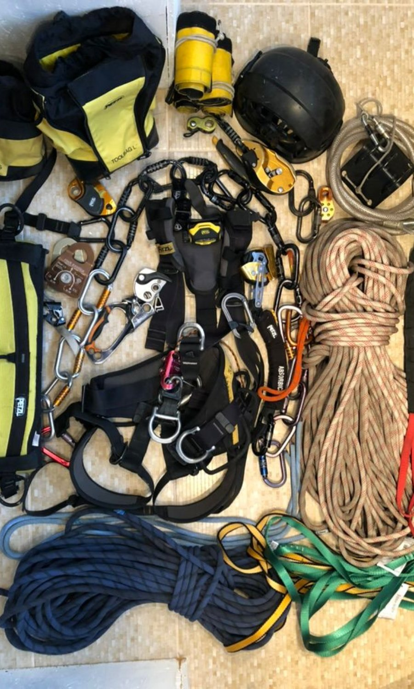
CLASSROOM → PRACTICAL
Day 1 Practical Training Plan
▸
Equipment inspection & buddy-check stations
▸
Knot tying / dressing / inspection repetitions
▸
Basic ascent and controlled descent
▸
Ascent ↔ descent changeovers
▸
Edge / start-position drills
▸
End-of-day competency check before Day 2
Photo: Mika343243 · CC BY-SA 4.0 · Wikimedia Commons
SKYTECH ACADEMY
DAY 1 · PRACTICAL
28
Notes:
Day 1 practical. Run inspection and buddy-check stations, then high-repetition knot work, then basic ascent, descent and changeovers, finishing with edge and start-position drills. End with a competency check — trainees must be stable on basic movement before Day 2 introduces obstacles.
Sources: SPRAT Rope Access Certification Requirements (CRC-01, v25A, Jan 2025) §6.
Discussion questions: Which inspection finding takes gear out of service? Which knot was hardest to dress? Where in a changeover are you most exposed?

Slide 28
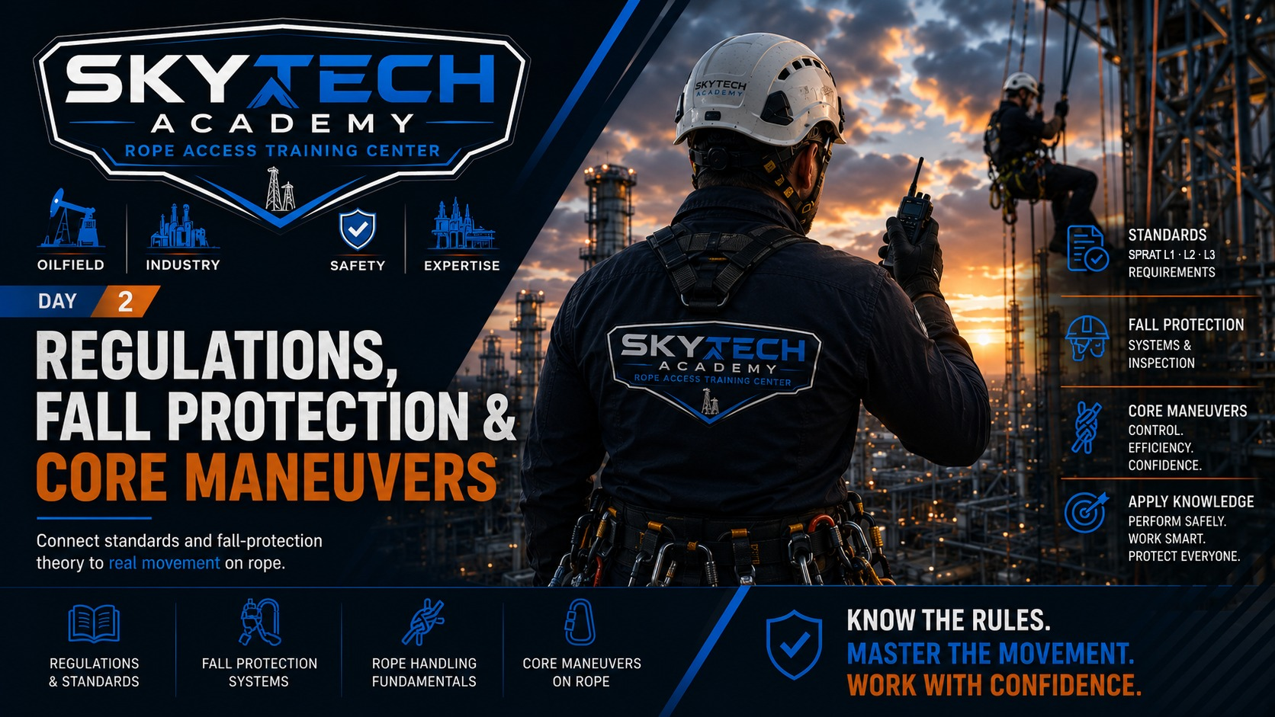
Notes:
Day start-off slide. Set the theme for the day and run the morning JSA before any practical activity.

Slide 29
DAY 2 · CLASSROOM
1–2 Hour Classroom — Regulations, Fall Protection & Core Maneuvers
01
Regulatory framework & SPRAT certification
DISCUSS Law, standard or SPRAT rule — which is it?
02
Fall-protection systems
DISCUSS Which system controls this hazard?
03
Fall factor, clearance & suspension
DISCUSS How far could you fall here?
04
Deviations
DISCUSS What does the deviation anchor carry?
05
Re-belays / re-anchors
DISCUSS What protects you mid-re-anchor?
06
Knot passing & rope-to-rope transfers
DISCUSS When is the new system ready to load?
INSTRUCTOR NOTE
Use trainee questions and site examples to connect each standard and technique to the practical stations that follow.
SKYTECH ACADEMY
DAY 2 · AGENDA
30
Notes:
Day 2 classroom agenda: the regulatory framework, fall-protection systems, fall factor and clearance, then the core obstacle maneuvers — deviations, re-belays, knot passing and transfers. Theory in the morning, all four maneuvers practiced in the afternoon.
Sources: SPRAT Rope Access Certification Requirements (CRC-01, v25A, Jan 2025) §2–6.

Slide 30
INSTRUCTOR DISCUSSION
DAY 2
Regulatory Framework
WHAT / HOW
WHY
WHEN / WHEN NOT
Know which rule set you are using
Why sources must stay distinct
Verify current editions
Separate legal requirements, consensus standards, certification-scheme rules, employer procedures and manufacturer instructions.
OSHA, ANSI and SPRAT serve different functions. Mixing them can turn guidance into a false legal requirement — or omit an actual one.
Use the current source for the work environment and certification scheme. Site / client rules may be more restrictive.
WHAT GOES WRONG
EVALUATOR'S EYE
TRAINEE Q&A
Memorizing numbers without context
Evaluator focus
“Does SPRAT replace OSHA?”
Applying one anchor rating, force limit or equipment rule universally is unsafe and often incorrect.
Trainees explain where a requirement comes from and when they must escalate to a supervisor / qualified person.
No. A certification scheme does not replace applicable law, employer duties or site requirements.
SKYTECH ACADEMY
DAY 2
31
Notes:
The regulatory framework. Keep the sources distinct: OSHA is law, ANSI is consensus best practice, SPRAT is the certification scheme, plus employer and manufacturer rules. Schemes never replace law. Teach trainees to say where a requirement comes from and when to escalate — memorizing a number without its source is dangerous.
Sources: OSHA 29 CFR 1910.140 and 1926 Subpart M; ANSI/ASSP Z359; SPRAT Safe Practices for Rope Access Work.

Slide 31
SPRAT PROGRAM
What Is SPRAT?
The Society of Professional Rope Access Technicians is a North American organization that publishes rope access safe-practice standards and certifies technicians at three levels.
L1
Rope Access Technician — Entry
No experience required · training within 6 months before evaluation · written test + practical.
GOVERNING DOCUMENTS
L2
Rope Access Technician — Intermediate
— Safe Practices for Rope Access Work
500 hrs + 6 months as L1 · system analysis · retrievable rigging · cross-haul · fall-arrest rescue.
— Certification Requirements
— Evaluation Guidelines & Matrix
— Defined Terms
L3
Rope Access Supervisor — Advanced
500 hrs + 6 months as L2 · tensioned systems · rescue from maneuvers · site supervision.
3 Years
Age 18+
1 F or 3 D
Certification cycle
Minimum entry requirement
Pass / Discrepancy / Fail
SKYTECH ACADEMY
SPRAT PROGRAM
33
Notes:
SPRAT reference. The Society of Professional Rope Access Technicians publishes Safe Practices for Rope Access Work, the Rope Access Certification Requirements and the Evaluation Guidelines. Three levels: L1 needs no experience; L2 needs 500 hours and 6 months as an L1; L3 needs 500 hours and 6 months as an L2. Every candidate is 18+, shows proof of ID, signs the evaluation affidavit and must be trained by a trainer within six months before initial certification at each level. Certificates are valid three years. One Fail or three Discrepancies fails the evaluation.
Sources: SPRAT Rope Access Certification Requirements (CRC-01, v25A, Jan 2025) §2–3; sprat.org.

Slide 32
INSTRUCTOR DISCUSSION
DAY 2
SPRAT Evaluation — How Candidates Are Graded
WHAT / HOW
WHY
WHEN / WHEN NOT
Written test + practical evaluation
Pass · Discrepancy · Fail
Safe and efficient
Certification requires passing a written test and a practical evaluation run by an independent SPRAT evaluator. The evaluator, not the trainer, has sole authority to issue grades.
Each exercise is graded P, D or F against the performance principles. One Fail or three Discrepancies fails the evaluation — several Ds can come from one exercise.
Every requirement must be completed safely and efficiently. SPRAT does not specify equipment or technique — the principles are what is graded.
WHAT GOES WRONG
EVALUATOR'S EYE
TRAINEE Q&A
Common discrepancy sources
What the evaluator watches
“What happens if I fail?”
Backup free fall over 4 ft, main-system free fall over 2 ft, swing fall over 2 ft, no backup in the fall zone, or a single component that could fail and drop the load.
A backup with every main system, free fall and swing within limits, chinstrap fastened in the fall zone, and no way to become detached.
The evaluator explains every D or F before your next exercise, and you receive a provisional result. Retrain the flagged skills before re-evaluating.
SKYTECH ACADEMY
DAY 2
34
Notes:
SPRAT evaluation. A written test and a practical evaluation are both required, run by an independent evaluator under Evaluations Committee policy. Each exercise is graded Pass, Discrepancy or Fail against the performance principles; one Fail or three Discrepancies fails the evaluation, and the evaluator explains every D or F before the next exercise. Limits to drill: backup free fall ≤ 1.2 m (4 ft), should be ≤ 0.6 m (2 ft); main-system free fall ≤ 0.6 m (2 ft); swing fall ≤ 0.6 m (2 ft); helmet chinstrap fastened in the fall zone (above the next lower level or within 2 m of an unprotected edge).
Sources: SPRAT Rope Access Certification Requirements (CRC-01, v25A, Jan 2025) §2.1–2.2, §4, §5.

Slide 33
INSTRUCTOR DISCUSSION
DAY 2
SPRAT Career Path — Eligibility & Renewal
WHAT / HOW
WHY
WHEN / WHEN NOT
Level 1 → Level 2 → Level 3
Each level adds responsibility
Renew every 3 years
L1: age 18+, government ID, no prior experience. L2: 500 hrs + 6 months as L1. L3: 500 hrs + 6 months as L2. Advancement is consecutive — no skipping levels.
L1 masters maneuvers, simple two-rope systems and a pick-off rescue. L2 adds system analysis, retrievable and remote-rescue rigging, cross-hauls and fall-arrest rescue. L3 adds tensioned systems and rescue from maneuvers.
Certification is valid for three years. Retrain and re-evaluate within the 6 months before expiry and the new certificate runs 3 years from the old expiry date.
WHAT GOES WRONG
EVALUATOR'S EYE
TRAINEE Q&A
Letting certification lapse
Documented, verified hours
“Is training required before evaluation?”
Hours worked without a valid certificate do not count toward an upgrade, and expired candidates must demonstrate every skill required at their level.
Upgrade candidates document 500 hours at their current level, recorded and verified as SPRAT Safe Practices require.
Yes. SPRAT requires training by a trainer within six months before initial certification at each level, and recommends it before any later evaluation.
SKYTECH ACADEMY
DAY 2
35
Notes:
SPRAT career path. L1: 18+, proof of ID, signed affidavit, no experience. L2: 500 documented hours at L1 and 6 months holding L1. L3: 500 documented hours at L2 and 6 months holding L2. Advancement is consecutive unless the Evaluations Committee approves otherwise. Hours worked without a valid certification do not count. Certificates last 3 years; recertifying in the last 6 months keeps the original anniversary. Training by a trainer within 6 months before initial certification is required. Many employers and evaluation hosts also ask L3 candidates for current First Aid/CPR — that is not in CRC-01 v25A, so present it as a host/employer requirement.
Sources: SPRAT Rope Access Certification Requirements (CRC-01, v25A, Jan 2025) §2.3, §3.

Slide 34
INSTRUCTOR DISCUSSION
DAY 2
Fall-Protection Systems
WHAT / HOW
WHY
WHEN / WHEN NOT
Choose the right control
Why system selection matters
Before connecting
Discuss elimination / avoidance, restraint, work positioning / rope access, and fall arrest. Identify which system is actually controlling the hazard.
Different systems assume different exposure and loading. Equipment appropriate for positioning may not be a complete fall-arrest solution.
Identify the hazard, system purpose, anchor strategy, clearance, swing exposure and rescue plan.
WHAT GOES WRONG
EVALUATOR'S EYE
TRAINEE Q&A
Using the wrong system
Evaluator focus
“If I have a lanyard, am I protected?”
Insufficient clearance, excessive free fall, poor anchor location, incompatible components and no viable rescue.
Can the trainee identify the system and explain what prevents or arrests the fall?
Only if the complete system — connection, anchor, clearance and use — is appropriate for the exposure.
SKYTECH ACADEMY
DAY 2
36
Notes:
The four fall-protection systems and the hierarchy: eliminate, restrain, position, and only arrest as a last resort. Rope access lives in work positioning with dual-rope redundancy. Teach trainees to name which system is controlling the hazard at any moment — a lanyard alone is not protection unless the whole system fits the exposure.
Sources: OSHA 29 CFR 1926.502(d); ANSI/ASSP Z359.2.

Slide 35
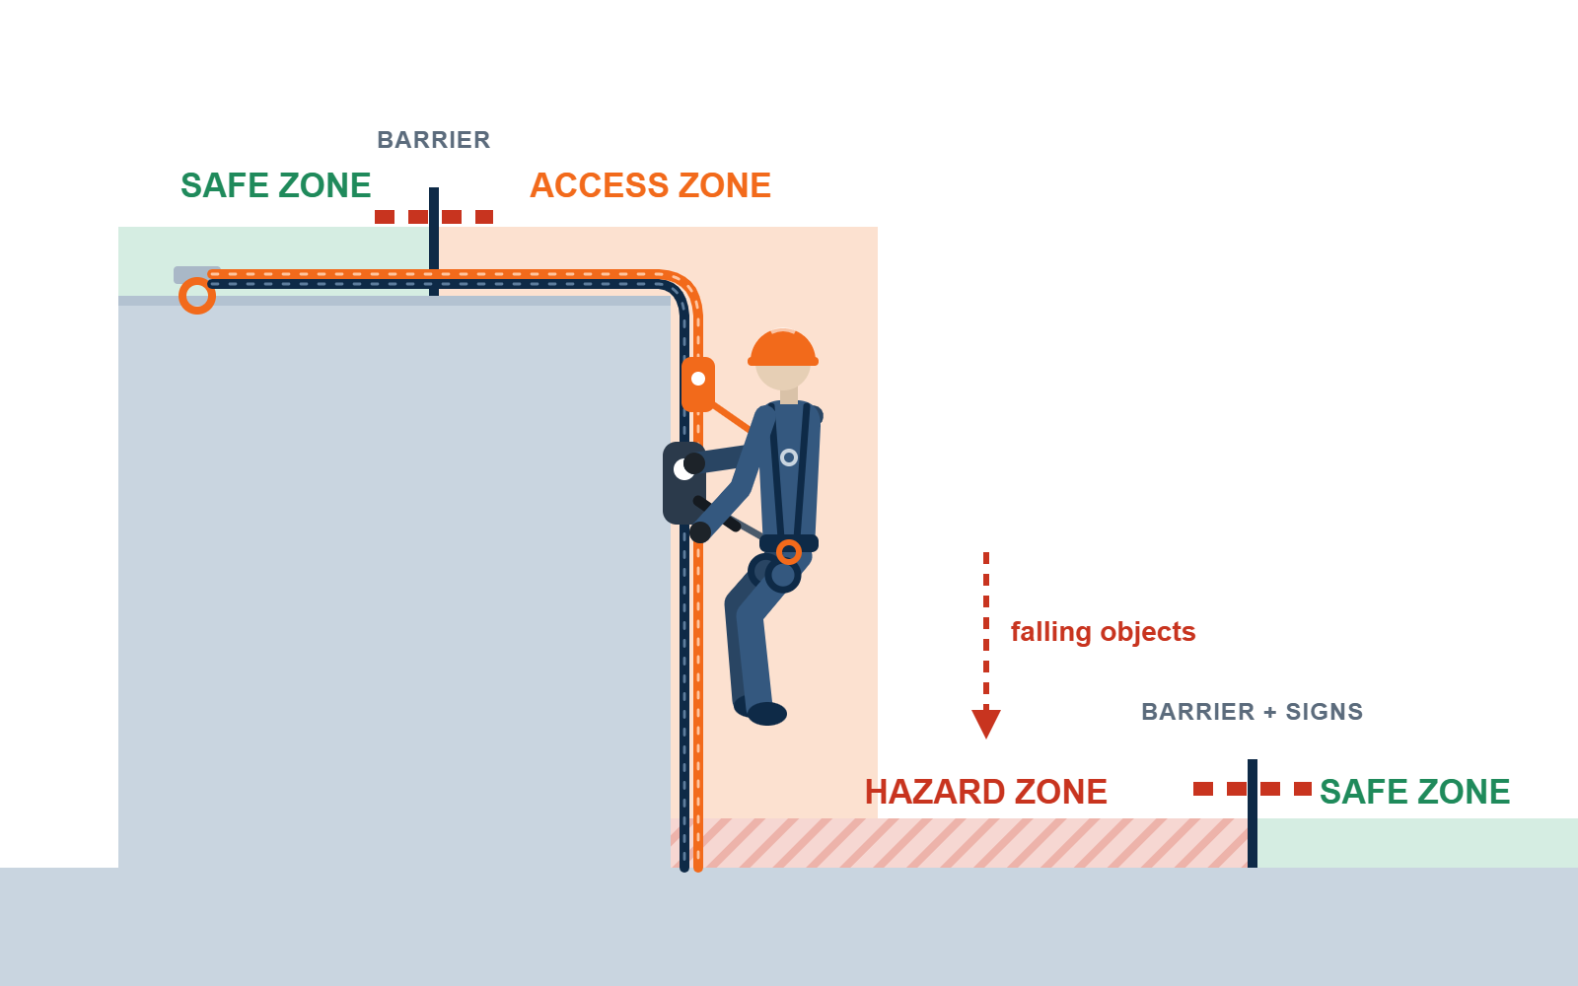
DAY 2 · WORKSITE ZONES — SEE IT
Access, Hazard and Safe Zones
ACCESS ZONE
The controlled area where rope access is taking place, where people are at risk of falling: on rope or near a working edge.
HAZARD ZONE
Areas around the Access Zone where people may be at risk from the work being performed, such as falling objects.
SAFE ZONE
Areas outside the Access and Hazard Zones, safe from the effects of the rope access work. That does not mean hazard-free.
THE RULE
Barricade and sign the Hazard Zone before work starts.
THE REMINDER
The Safe Zone is safe from the rope access work. It is not free of every hazard.
SKYTECH ACADEMY
REFERENCE · WORKSITE ZONES
32
Notes:
Worksite zones. Access Zone: where people can fall. Hazard Zone: below and around, exposed to falling objects — barricade and sign it before work starts. Safe Zone: outside both. Ask trainees to mark the three zones on a real SkyTech job photo. Sources: SPRAT Safe Practices for Rope Access Work; employer JSA procedure.

Slide 36
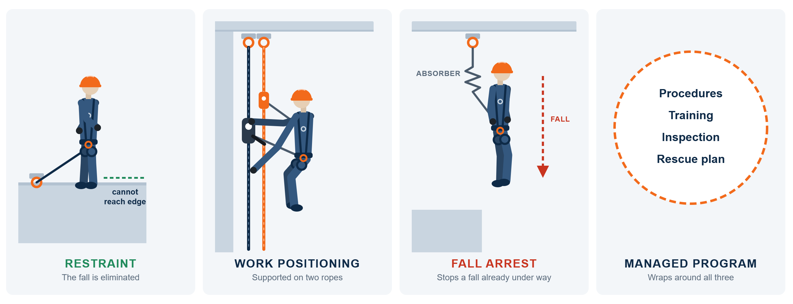
DAY 2 · FALL PROTECTION — SEE IT
Four Systems — Prevent First, Arrest Last
THE ORDER
Restraint first, work positioning for rope access, fall arrest only as the last resort.
THE WRAPPER
A managed program covers procedures, training, inspection and rescue for every system.
SKYTECH ACADEMY
REFERENCE · FALL-PROTECTION SYSTEMS
37
Notes:
Four systems. Restraint eliminates the fall; work positioning (rope access) supports the worker on two ropes; fall arrest stops a fall already under way; a managed program wraps around all three. Sources: ANSI/ASSP Z359.2; OSHA 29 CFR 1910.140.

Slide 37
INSTRUCTOR DISCUSSION
DAY 2
Fall Factor, Clearance & Suspension
WHAT / HOW
WHY
WHEN / WHEN NOT
Understand the consequences of a fall
Why calculations matter
Plan before exposure
Explain fall potential, energy absorption, clearance components, swing hazards, and the need for prompt rescue after a fall or incapacitation.
A compliant component does not guarantee a safe system if there is insufficient clearance or the geometry creates impact / swing hazards.
Evaluate the complete arrest path and rescue access before work begins.
WHAT GOES WRONG
EVALUATOR'S EYE
TRAINEE Q&A
Generic shortcuts
Evaluator focus
“How much clearance do I need?”
Do not rely on a universal “20-minute” rule or a simplified clearance guess. Treat motionless suspension as urgent and use current rescue / medical guidance.
Candidate identifies free-fall / clearance concerns and does not proceed when the available space is uncertain.
It depends on the complete system. Calculate using the manufacturer / system data plus an appropriate safety margin.
SKYTECH ACADEMY
DAY 2
38
Notes:
Fall factor, clearance and suspension. Fall factor = fall distance ÷ rope length; keep the backup high to keep it near zero. Clearance is the total room a fall needs — free fall + absorber deployment + harness stretch + margin — often far more than trainees expect. Treat motionless suspension as an urgent rescue, and avoid the outdated universal
Sources: SPRAT Rope Access Certification Requirements (CRC-01, v25A, Jan 2025) §4.1.5, §4.2.5; OSHA 29 CFR 1926.502(d)(16); manufacturer clearance data.

Slide 38
DAY 2 · FALL-PROTECTION REFERENCE
Four Systems & Fall-Arrest Limits
PREVENT · PREFERRED
SUPPORT · ROPE ACCESS
LAST RESORT
THE WRAPPER
Restraint
Work Positioning
Fall Arrest
Managed Program
Worker cannot reach the hazard — the fall is eliminated.
Supported for hands-free work; dual-rope redundancy.
Stops the worker after a fall begins — force reaches the body.
Procedures, training and inspection (ANSI Z359.2) around it all.
CONNECTION
PEAK FORCE
SOURCE
MAX FREE FALL
WHY ABSORBERS WORK
Sternal (front)
900 lb · 4 kN
Harness label
2 ft
Force = mass × deceleration. An absorber tears progressively, stretching the stop over more time — more tear time, less peak force.
Dorsal (back)
1,800 lb · 8 kN
OSHA 1926.502
6 ft*
* OSHA also limits deceleration distance to 3.5 ft · always follow the harness label
SKYTECH ACADEMY
REFERENCE · SYSTEMS & ARREST FORCES
39
Notes:
Reference to pair with fall protection. Hierarchy: eliminate, restrain, position (rope access), and arrest only as a last resort. OSHA limits a personal fall-arrest system with a body harness to 1,800 lbf maximum arrest force, 6 ft free fall and 3.5 ft deceleration distance. Front (sternal) fall-arrest use is limited by the harness standard and label — confirm the free-fall and force limits on each harness. An energy absorber lowers peak force by extending the stopping distance.
Sources: OSHA 29 CFR 1926.502(d)(16); ANSI/ASSP Z359.2, Z359.11; harness label.

Slide 39
DAY 2 · FALL-PROTECTION REFERENCE
Fall Factor & Clearance — the Two Calculations
FF = Fall ÷ Rope
CLEARANCE — WORKED EXAMPLE
3-ft cowstail — where you keep the backup decides everything.
6-ft energy-absorbing lanyard, 6-ft worker · example values
Free fall (lanyard length)
6.0 ft
FF 0
Backup above attachment · 0 ft ÷ 3 ft = 0
Absorber deployment (OSHA max)
3.5 ft
FF 1
Backup level with attachment · 3 ft ÷ 3 ft = 1
D-ring to feet (worker height)
5.0 ft
Harness stretch + D-ring shift
1.0 ft
FF 2
Backup at feet · 6 ft ÷ 3 ft = 2 — over 4-ft limit
Safety margin
2.0 ft
Clearance needed below anchor
17.5 ft
Most-watched habit on assessment: SPRAT caps backup free fall at 4 ft (aim ≤ 2 ft) and main-system free fall at 2 ft. Keep the backup high.
The shock: working 15 ft above the ground with this lanyard, you hit the ground before the fall is arrested. Use your own system’s numbers.
SKYTECH ACADEMY
REFERENCE · FALL FACTOR & CLEARANCE
40
Notes:
Fall factor = free-fall distance ÷ lanyard length: with a 3-ft cowstail, backup above = 0, level = 3 ÷ 3 = 1, at the feet = 6 ÷ 3 = 2. SPRAT caps backup free fall at 4 ft. Clearance worked example for a 6-ft energy-absorbing lanyard: 6.0 ft free fall + 3.5 ft deceleration (OSHA maximum) + 5.0 ft D-ring to feet + 1.0 ft harness stretch and D-ring shift + 2.0 ft margin = 17.5 ft below the anchor. Have trainees redo the sum with their own lanyard label and height. Sources: OSHA 29 CFR 1926.502(d)(16); SPRAT CRC-01 v25A §4.2.5; manufacturer clearance data.
Sources: SPRAT Rope Access Certification Requirements (CRC-01, v25A, Jan 2025) §4.2.5; OSHA 29 CFR 1926.502(d)(16); manufacturer clearance data.

Slide 40
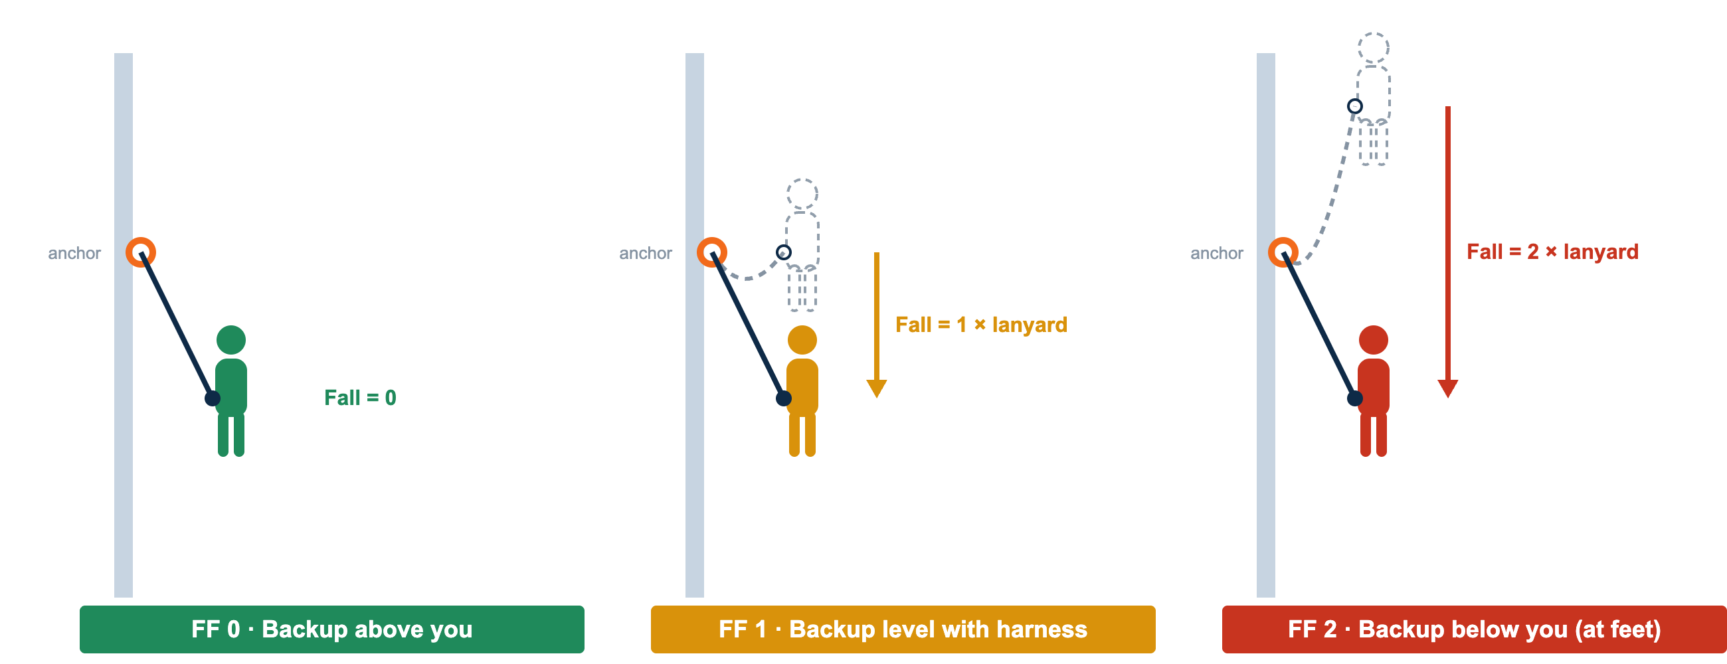
DAY 2 · FALL FACTOR — SEE IT
Fall Factor — Where the Backup Sits Decides the Fall
THE FORMULA
Fall factor = distance fallen ÷ length of lanyard
THE HABIT
Keep the backup above your harness attachment — aim for FF 0 on every move.
SKYTECH ACADEMY
REFERENCE · FALL FACTOR
41
Notes:
Picture version of fall factor. FF 0: backup above the harness — no free fall. FF 1: backup level with the harness — the technician falls one lanyard length. FF 2: backup below the harness — the fall is twice the lanyard length and the shock is highest. Have trainees stand in each position on the practice structure.
Sources: SPRAT Rope Access Certification Requirements (CRC-01, v25A, Jan 2025) §4.2.5.

Slide 41
INSTRUCTOR DISCUSSION
DAY 2
Deviations
WHAT / HOW
WHY
WHEN / WHEN NOT
Redirect the rope path safely
Why deviations are used
Use when geometry supports it
Approach under control, manage both systems, transfer the deviation connection in sequence and control pendulum / swing potential.
They redirect ropes around hazards, improve access geometry, or protect the system without creating a full re-anchor.
Consider deviation angle, rescue implications and whether the redirection creates dangerous swing or loading.
WHAT GOES WRONG
EVALUATOR'S EYE
TRAINEE Q&A
Disconnecting in the wrong order
Evaluator focus
“Is a deviation an anchor?”
Loss of protection, uncontrolled swing, trapping the device or loading a connector incorrectly.
Continuous protection, correct sequence, controlled body position and awareness of swing hazards.
It redirects the rope path — teach the specific system design; do not assume it functions like a primary independent anchor.
SKYTECH ACADEMY
DAY 2
42
Notes:
Deviations redirect the rope path around a hazard or to improve geometry. Pass one connection at a time, never both off together, and control the swing. The key correction: a deviation is not a primary anchor — it redirects, it does not carry the system the way an independent anchor does.
Sources: SPRAT Rope Access Certification Requirements (CRC-01, v25A, Jan 2025) §6.4, §4.2.6.

Slide 42
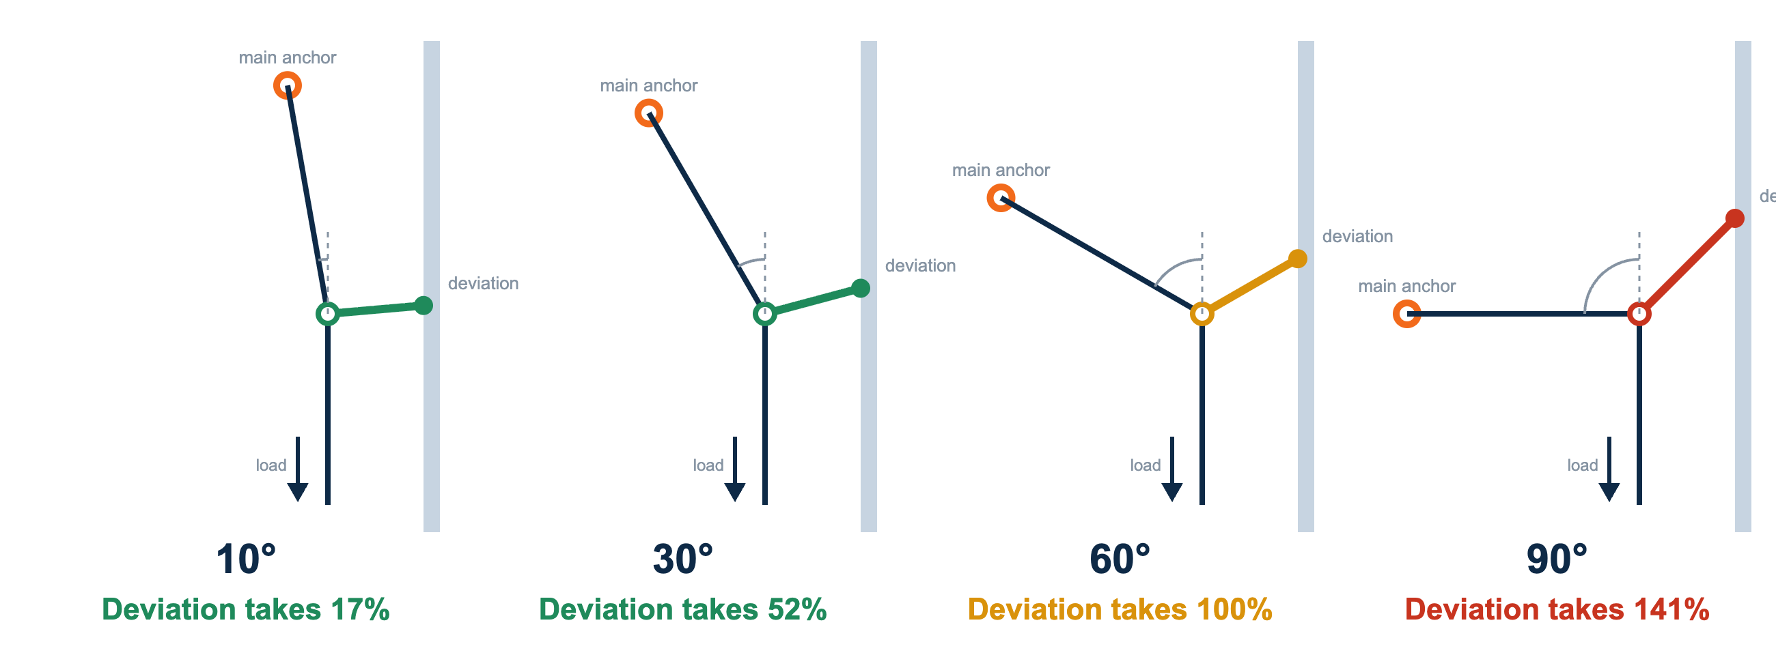
DAY 2 · DEVIATIONS — SEE IT
Deviations — The Bigger the Angle, the Bigger the Load
WHY IT MATTERS
Load on the deviation = 2 × sin(½ × angle) × load. A small redirect puts little load on the deviation anchor and sling; at 60° the deviation carries as much as the main anchor, and beyond that it carries more. Choose deviation anchors and slings rated for that load.
SKYTECH ACADEMY
REFERENCE · DEVIATION FORCES
43
Notes:
Deviation forces. The deflection angle is measured between the rope’s original line and its redirected line. Load on the deviation = 2 × sin(half the angle) × the rope load: about 17% at 10°, 52% at 30°, 100% at 60°, 141% at 90°. Keep deviations shallow unless the deviation anchor is rated as a primary anchor.
Sources: SPRAT Rope Access Certification Requirements (CRC-01, v25A, Jan 2025) §6.4; force = 2 × sin(½ angle) × load.

Slide 43
INSTRUCTOR DISCUSSION
DAY 2
Re-belays / Re-anchors
WHAT / HOW
WHY
WHEN / WHEN NOT
Transfer past a new anchor station
Why re-belays are used
Plan the sequence before arriving
Build / verify the next protected section, transfer devices in a controlled order and never create an unprotected moment.
They isolate rope sections, manage edges and obstructions, reduce stretch, or create better access geometry.
Know where each device and connection will go before unloading the existing section.
WHAT GOES WRONG
EVALUATOR'S EYE
TRAINEE Q&A
Crowding and wrong sequence
Evaluator focus
“Which device moves first?”
Loading both systems incorrectly, excessive loop slack, trapped devices, dropped connections or loss of redundancy.
Safe order, controlled loading / unloading, tidy rope management and independent protection throughout.
Follow the approved technique and understand what is supporting / protecting you at every step — do not memorize an isolated trick.
SKYTECH ACADEMY
DAY 2
44
Notes:
Re-belays / re-anchors transfer you past a new anchor station to isolate a rope section or manage an edge. Plan the whole sequence before arriving; keep one protected connection at all times. Trainees fixate on
Sources: SPRAT Rope Access Certification Requirements (CRC-01, v25A, Jan 2025) §6.7.

Slide 44
INSTRUCTOR DISCUSSION
DAY 2
Knot Passing & Rope-to-Rope Transfers
WHAT / HOW
WHY
WHEN / WHEN NOT
Move around an obstruction or onto another system
Why these skills matter
Use only with a planned destination
Real access routes include knots, damaged-section isolation, separate drops and changes in work position.
Verify the target ropes / anchors and manage swing, spacing and rescue implications.
Establish the new support / protection before progressively unloading the old system; manage devices so no step creates uncontrolled movement.
WHAT GOES WRONG
EVALUATOR'S EYE
TRAINEE Q&A
Committing too early
Evaluator focus
“Can I transfer faster by moving both devices together?”
Unloading the old system before the new one is complete, attaching both devices to one rope, or creating excessive slack.
Deliberate sequence, correct system identification and the ability to pause safely mid-transfer.
Speed is secondary. Maintain a clear support / protection strategy through each individual step.
SKYTECH ACADEMY
DAY 2
45
Notes:
Knot passing and rope-to-rope transfers. Establish the new support fully before unloading the old — mid-transfer you are on both systems, never fewer than two connections. Verify the destination ropes and anchors first. The recurring error is committing too early; the graded behavior is the ability to pause safely mid-transfer.
Sources: SPRAT Rope Access Certification Requirements (CRC-01, v25A, Jan 2025) §6.5–6.6.

Slide 45
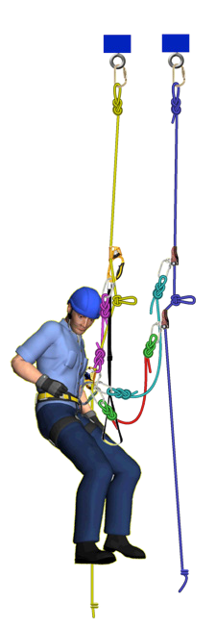
DAY 2 · KNOT PASSING — EXERCISE
Knot-Pass Exercise — Pass a Knot on Descent
SEQUENCE — NEVER FEWER THAN TWO ATTACHMENTS
1
Stop just above the knot
Lock off the descender; backup kept high
2
Clip a short cowstail into the knot loop
Safety connection, gate locked
3
Fit the ascender above the descender, stand up
Weight onto the ascender, then remove the descender
4
Refit the descender below the knot
Lock it, load it, then remove the ascender and cowstail
5
Pass the backup separately
Only if the knot is on the backup rope too — stay clipped while moving it
Check: the new device is loaded and locked before the old one comes off.
SKYTECH ACADEMY
EXERCISE · KNOT PASSING
48
Notes:
Knot-pass exercise. A knot in the working rope (a join or isolated damage) must be passed without ever having fewer than two attachments. Demonstrate at low height first; trainees call each step before doing it. Pair with the knot-passing diagram slide. Source: SPRAT CRC-01 v25A — Level 1 knot passing (verify section number). Image: supplied by SkyTech — confirm usage rights.

Slide 46
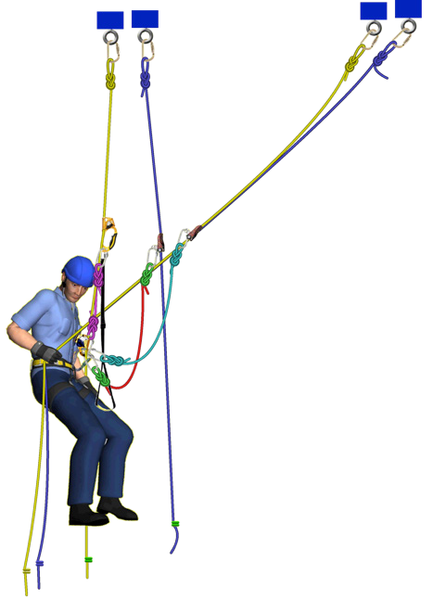
DAY 2 · ROPE-TO-ROPE TRANSFER — EXERCISE
Rope-to-Rope Transfer — Move Across Without Losing Two Points
SEQUENCE
1
Stop level with the new rope set
Descender locked on the current working rope
2
Connect a cowstail to the new ropes
Clip the anchor knot or a rope grab
3
Fit the backup on the new backup rope
Above your attachment point
4
Fit the descender on the new working rope
Lock it, then take your weight onto it
5
Remove devices from the old ropes
One at a time, after the new system holds you
Never unclip the old system until the new working rope and backup are both on and loaded.
SKYTECH ACADEMY
EXERCISE · ROPE-TO-ROPE TRANSFER
46
Notes:
Rope-to-rope transfer exercise, a SPRAT Level 1 maneuver. Point out that two independent attachments are kept throughout and that the new backup goes on before the old one comes off. Sources: SPRAT CRC-01 v25A §6.5. Image: supplied by SkyTech — confirm usage rights.

Slide 47
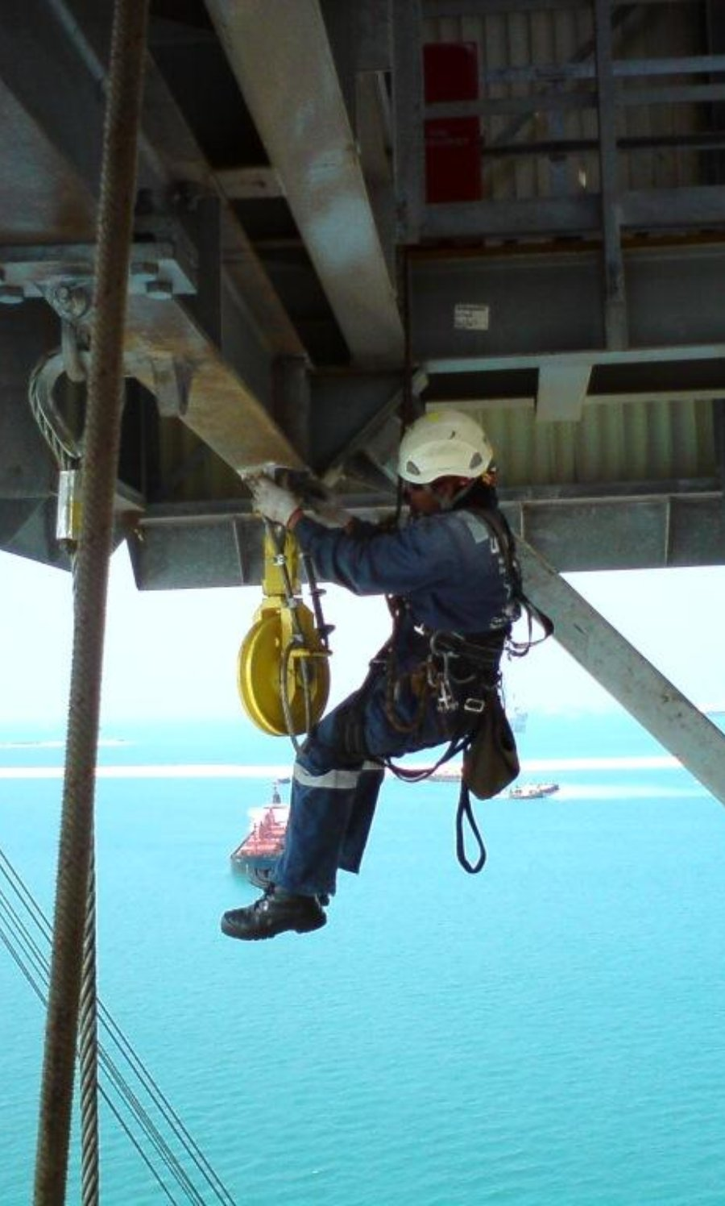
CLASSROOM → PRACTICAL
Day 2 Practical Training Plan
▸
Fall-protection setup discussion at the structure
▸
Deviation progression: demo → coached → independent
▸
Re-belay / re-anchor progression
▸
Passing knots
▸
Rope-to-rope transfers
▸
Combined maneuver circuit with evaluator-style observation
Photo: Archer7319 · public domain · Wikimedia Commons
SKYTECH ACADEMY
DAY 2 · PRACTICAL
49
Notes:
Day 2 practical. Each maneuver runs demo → coached → independent. Finish with a combined circuit under evaluator-style observation so trainees experience linking maneuvers without step-by-step prompting.
Sources: SPRAT Rope Access Certification Requirements (CRC-01, v25A, Jan 2025) §6.
Discussion questions: Which maneuver came closest to an unprotected moment? Where was your backup? How far could you have fallen?

Slide 48
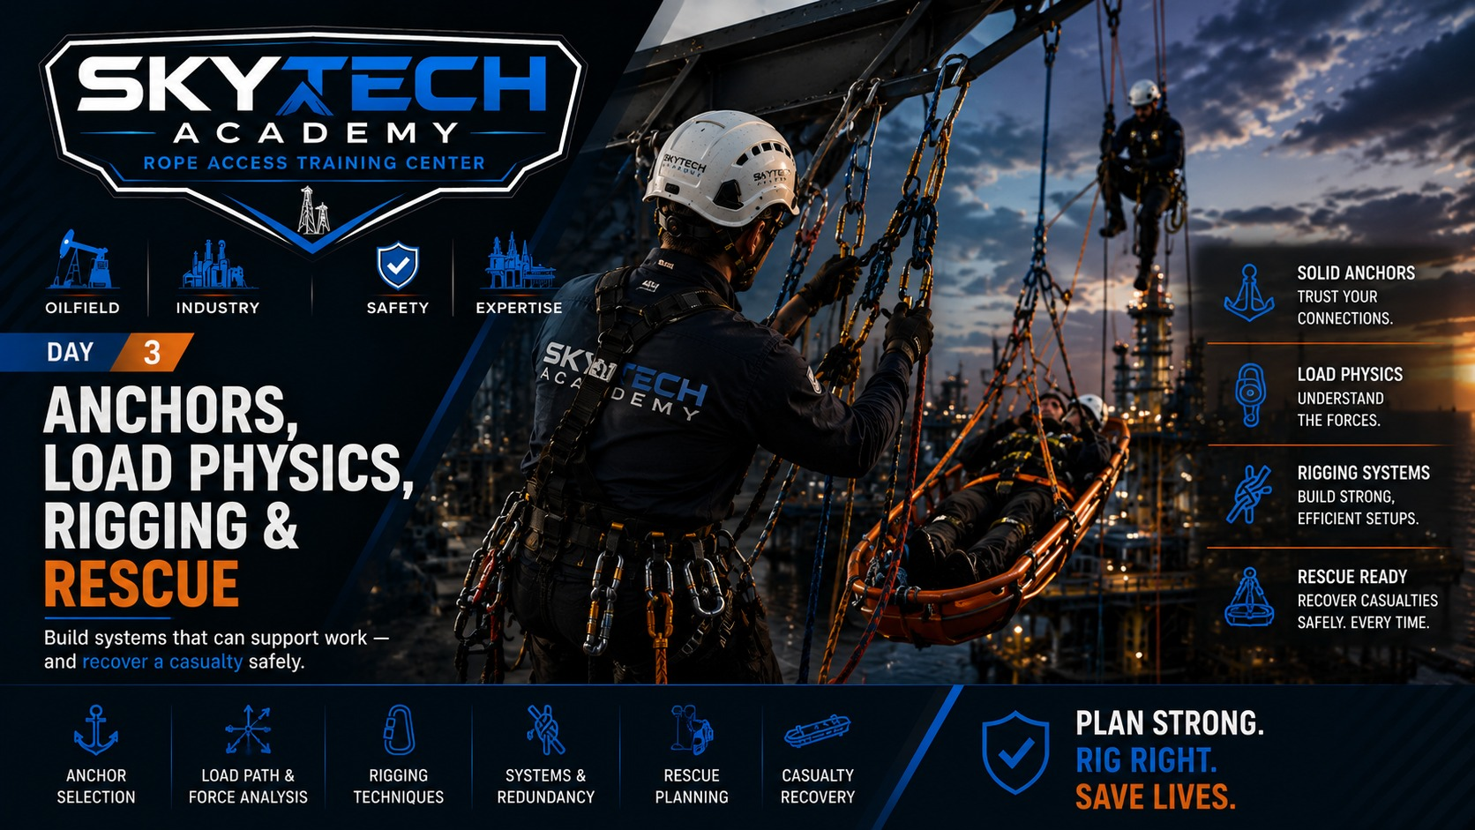
Notes:
Day start-off slide. Set the theme for the day and run the morning JSA before any practical activity.

Slide 49
DAY 3 · CLASSROOM
1–2 Hour Classroom — Anchors, Load Physics, Rigging & Rescue
01
Anchor selection & independence
DISCUSS Verified anchor — or just convenient?
02
Anchor angles & load sharing
DISCUSS What does each leg see at this angle?
03
MBS, WLL / SWL & equipment limits
DISCUSS Where is the working limit written?
04
Lowering & hauling systems
DISCUSS Lower or haul — and why?
05
Releasable rigging & edge management
DISCUSS Can this rig be lowered under load?
06
Rescue fundamentals & Level 1 progression
DISCUSS Is the rescuer safe first?
07
Level 2 rescue through obstacles
DISCUSS What is the plan for every obstacle?
INSTRUCTOR NOTE
Seven topics today — keep each tight and lean on demonstrations. Load physics must be understood before rigging, and rigging before rescue.
SKYTECH ACADEMY
DAY 3 · AGENDA
51
Notes:
Day 3 classroom agenda — seven topics, the densest day. Anchors and load physics come first because you cannot rig safely without them, then lowering/hauling and releasable rigging, then the Level 1 and Level 2 rescue progressions.
Sources: SPRAT Rope Access Certification Requirements (CRC-01, v25A, Jan 2025) §6–8.

Slide 50
INSTRUCTOR DISCUSSION
DAY 3
Anchor Selection & Independence
WHAT / HOW
WHY
WHEN / WHEN NOT
Verify the structure and load path
Why “strong-looking” is not enough
Before rigging
Use suitable anchorages for the intended direction and system. Maintain independence and avoid common-mode failure.
Unknown structure, corrosion, poor load direction or shared failure points can defeat otherwise strong equipment.
Confirm structural suitability through the approved process and protect ropes from edges, heat, chemicals and movement.
WHAT GOES WRONG
EVALUATOR'S EYE
TRAINEE Q&A
Convenience anchoring
Evaluator focus
“Can I use this beam / rail?”
Handrails, pipework, cable tray or unverified steel selected simply because they are nearby.
Anchor choice, direction of load, independence, edge protection and rescue implications.
Only after it is verified as suitable under the applicable engineering / site process — not by appearance alone.
SKYTECH ACADEMY
DAY 3
52
Notes:
Anchor selection. No anchor, no safe system — anchor failure is total failure. Two independent anchors, verified structure, correct load direction, edge protection. The classic error is convenience anchoring to a handrail or pipe. A handrail is not an anchor until the approved process says it is.
Sources: SPRAT Rope Access Certification Requirements (CRC-01, v25A, Jan 2025) §4.2.2, §6.10, §7.5; OSHA 29 CFR 1926.502(d)(15).

Slide 51
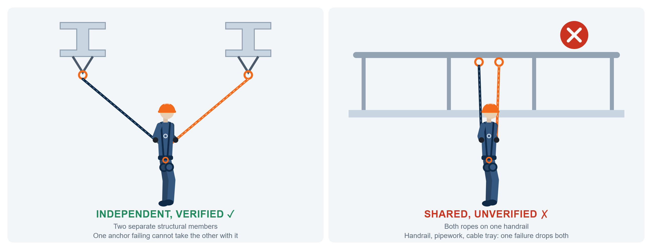
DAY 3 · ANCHORS — SEE IT
Anchor Independence — One Failure Must Not Drop Both Ropes
THE TEST
Is the structure verified, and can one anchor fail without affecting the other?
THE TRAP
Handrails, pipework or cable tray chosen because they are nearby.
SKYTECH ACADEMY
REFERENCE · ANCHORS
53
Notes:
Anchor independence. Each rope gets its own verified structural anchor so one failure cannot drop both. Handrails, pipework and cable tray are not anchors unless verified. Sources: SPRAT Rope Access Certification Requirements (CRC-01, v25A, Jan 2025) §6.10; OSHA 29 CFR 1926.502(d)(15).

Slide 52
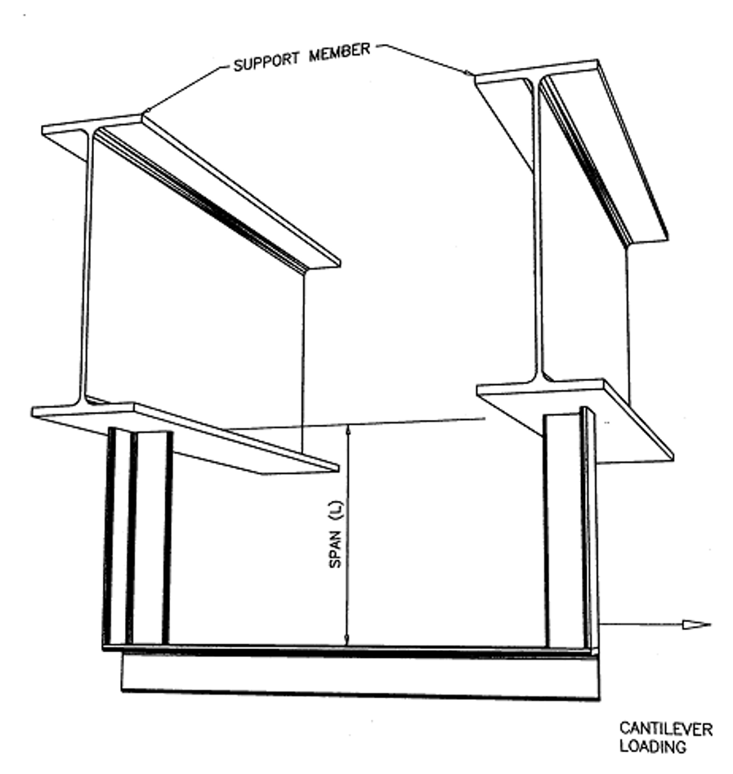
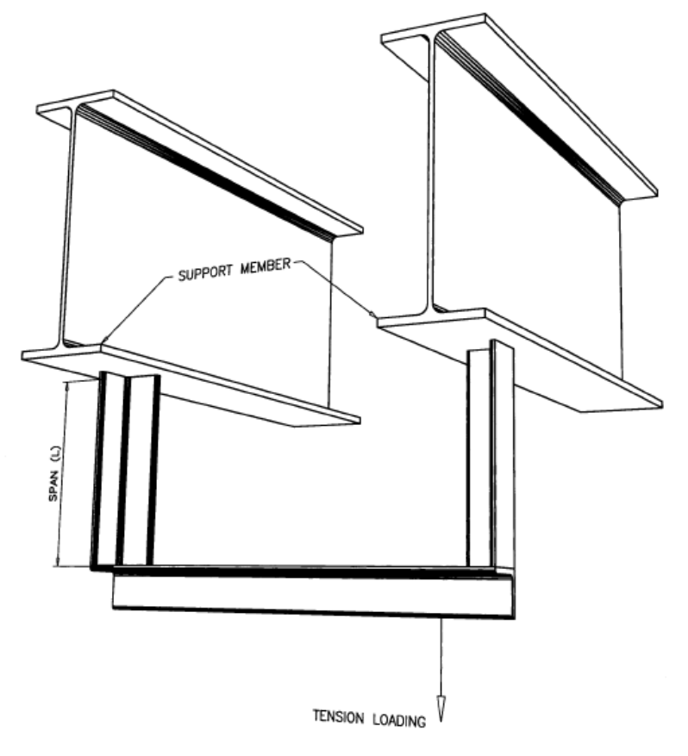
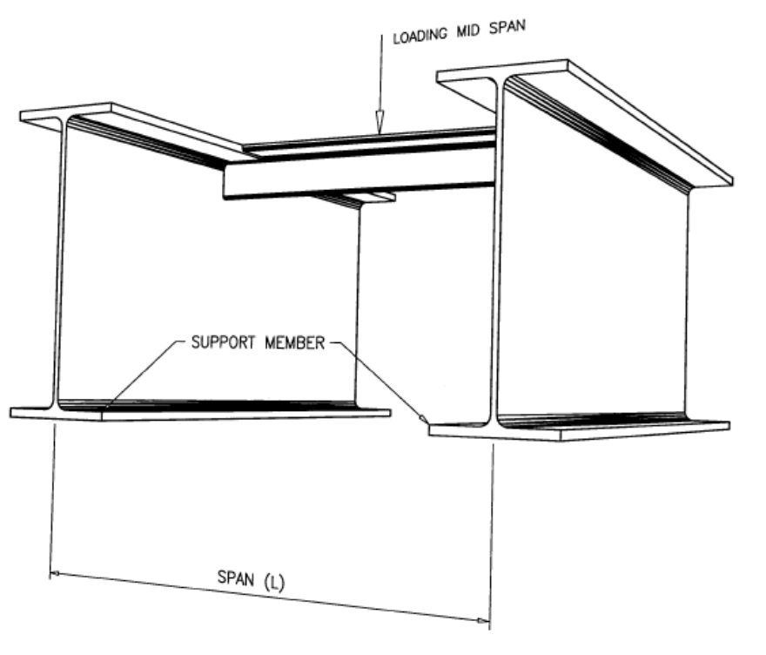
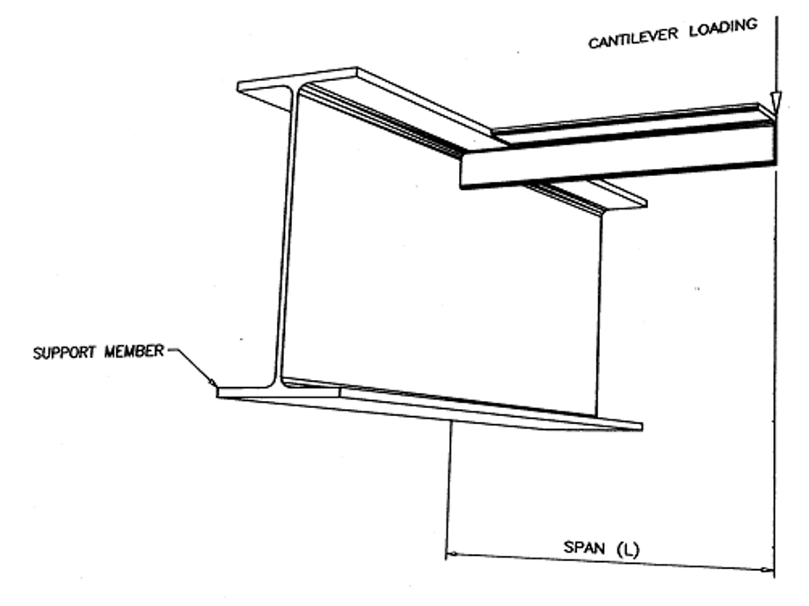
DAY 3 · ANCHORS — STRUCTURAL STEEL
Structural Steel Anchors — Know the Load Case
FIG 1 · MIDSPAN
Load hangs between two supports
Span = distance between the supports
FIG 2 · CANTILEVER
Load at the free end of an overhang
Span = overhang past the support
FIG 3 · CANTILEVER (SIDE PULL)
Load pulls sideways on a hanging member
Span = drop below the support
FIG 4 · TENSION
Load pulls straight down the member
Span = drop below the support
Same member, different answer. A beam that holds in tension can fail as a cantilever. Identify the load case and the span before you pick the anchor.
SKYTECH ACADEMY
ANCHORS · LOAD CASES
54
Notes:
Structural steel load cases. Walk through each figure: midspan (load between two supports), cantilever (load on an overhang or side pull), tension (straight pull down the member). The span is measured differently in each case. Source: supplied steel-anchor chart — confirm the originating standard before teaching.

Slide 53
DAY 3 · ANCHORS — STRUCTURAL STEEL
Is This Steel Member a Suitable Anchor?
MIDSPAN
CANTILEVER
TENSION
MIDSPAN
CANTILEVER
TENSION
2 ft
5 ft
10 ft
2 ft
5 ft
10 ft
2 ft
5 ft
10 ft
2 ft
5 ft
10 ft
2 ft
5 ft
10 ft
2 ft
5 ft
10 ft
I-BEAM (W)
PIPE (SCHD 40)
W4
YES
YES
NO
NO
NO
NO
YES
YES
YES
2″
NO
NO
NO
NO
NO
NO
NO
NO
NO
W6
YES
YES
NO
NO
NO
NO
YES
YES
YES
3″
YES
NO
NO
NO
NO
NO
YES
YES
YES
W8
YES
YES
YES
YES
NO
NO
YES
YES
YES
4″
YES
NO
NO
NO
NO
NO
YES
YES
YES
W10
YES
YES
YES
YES
NO
NO
YES
YES
YES
5″
YES
YES
NO
NO
NO
NO
YES
YES
YES
W12
YES
YES
YES
YES
YES
NO
YES
YES
YES
6″
YES
YES
YES
YES
NO
NO
YES
YES
YES
SQUARE TUBE (TS)
ANGLE (L)
TS 2×2
NO
NO
NO
NO
NO
NO
YES
YES
YES
L 3×3
NO
NO
NO
NO
NO
NO
NO
NO
NO
TS 3×3
YES
NO
NO
NO
NO
NO
YES
YES
YES
L 4×4
NO
NO
NO
NO
NO
NO
YES
YES
YES
TS 4×4
YES
NO
NO
NO
NO
NO
YES
YES
YES
L 5×5
YES
NO
NO
NO
NO
NO
YES
YES
YES
TS 5×5
YES
YES
NO
NO
NO
NO
YES
YES
YES
L 6×6
YES
NO
NO
NO
NO
NO
YES
YES
YES
TS 6×6
YES
YES
YES
YES
NO
NO
YES
YES
YES
CHANNEL (C)
C4
YES
NO
NO
NO
NO
NO
YES
YES
YES
READ IT LIKE THIS
Tension is almost always YES. Cantilever is almost always NO. Longer span = weaker anchor.
C6
YES
YES
NO
NO
NO
NO
YES
YES
YES
C8
YES
YES
—
YES
NO
—
YES
YES
—
C10
YES
YES
YES
YES
NO
NO
YES
YES
YES
Acceptable per fall-protection standard for the loading shown (figures on the previous slide). Blank = not listed. Planning aid only — a qualified person approves every anchor.
SKYTECH ACADEMY
ANCHORS · STEEL MEMBER CHART
55
Notes:
Steel member chart. Have trainees find a member and span on the chart, then say whether it is acceptable for each load case. Point out the pattern: tension is strongest, cantilever weakest, and acceptability drops as span grows. Source: supplied chart, “acceptable per fall protection standard” — confirm which standard and edition. Planning aid only; a qualified person approves anchors.

Slide 54
INSTRUCTOR DISCUSSION
DAY 3
Anchor Angles & Load Sharing
WHAT / HOW
WHY
WHEN / WHEN NOT
Geometry changes force
Why this matters
Keep geometry conservative
Explain how the included angle affects leg tension and why increasingly wide bridles create high forces.
A multi-anchor system can overload components if geometry is poor — even when the suspended load itself seems modest.
Use manufacturer / engineering guidance for exact limits and avoid unnecessarily wide included angles.
WHAT GOES WRONG
EVALUATOR'S EYE
TRAINEE Q&A
False “equalization” assumptions
Evaluator focus
“Is 120° always safe?”
Unequal leg lengths, stretch, direction changes and movement can prevent true equal load sharing.
Candidate recognizes poor geometry and can explain why flattening a bridle increases leg force.
No angle is automatically safe. The complete engineered / approved system and component limits control.
SKYTECH ACADEMY
DAY 3
56
Notes:
Anchor angles. As the included angle widens, force per leg climbs sharply — near 90° each leg carries ~71%, at 120° a full 100%, beyond that it multiplies past the total load. Keep angles at or below 90°. Teach why flattening a bridle is dangerous, and that
Sources: Force per leg = load ÷ (2 × cos(½ angle)).

Slide 55
DAY 3 · LOAD PHYSICS REFERENCE
Included Angles — the Wide V Multiplies the Load
ANGLE
FORCE / ANCHOR
STATUS
WORKED EXAMPLE — DO THE MATH
0°
50% of load
Ideal
ANGLE
LOAD
FORCE / LEG
90°
220 lb
≈ 156 lbf
45°
54%
Good
120°
180 lb
180 lbf
90°
71%
Limit of preferred
160°
220 lb
≈ 634 lbf
120°
100% — no sharing
Critical
At 160° each anchor sees nearly 3× the entire load — geometry alone made it dangerous.
150°
193%
Danger
THE RULES
160°
288%
Extreme danger
Keep the included angle at 90° or less where practical.
Wider than a right angle? Re-rig with longer slings or a higher master point.
SKYTECH ACADEMY
REFERENCE · ANCHOR INCLUDED ANGLES
57
Notes:
Reference to pair with anchor angles. Force per leg by included angle: 0°→50%, 45°→54%, 90°→71%, 120°→100% (no sharing benefit), 150°→193%, 160°→288%. As legs flatten, each leg fights the other instead of holding the load. Keep ≤90°, never approach 120°. Worked: 220 lb at 90° ≈ 156 lbf/leg; at 160° ≈ 634 lbf/leg — nearly 3× the whole load per anchor. Flatter than a right angle? Re-rig with longer slings or a higher master point.
Sources: Force per leg = load ÷ (2 × cos(½ angle)).

Slide 56
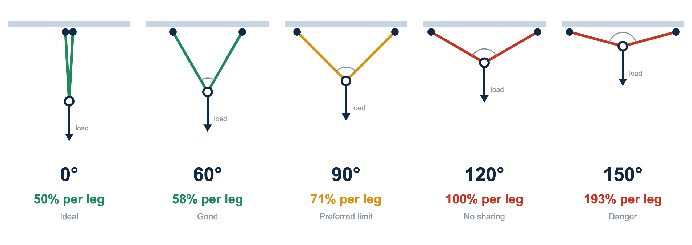
DAY 3 · LOAD PHYSICS — SEE IT
Anchor Angles — Watch the Load Grow
THE RULE
Force per leg = load ÷ (2 × cos(½ × angle)). Keep the included angle at 90° or less. At 120° each anchor holds the full load; past that, each anchor holds more than the load itself. Too wide? Re-rig with longer slings or a higher master point.
SKYTECH ACADEMY
REFERENCE · ANCHOR ANGLES
58
Notes:
Picture version of included angles. Per-leg force = load ÷ (2 cos(angle/2)): 0° 50%, 60° 58%, 90° 71%, 120° 100%, 150° 193%. Build each on the training frame with a load cell if available so trainees see the numbers change.
Sources: Force per leg = load ÷ (2 × cos(½ angle)).

Slide 57
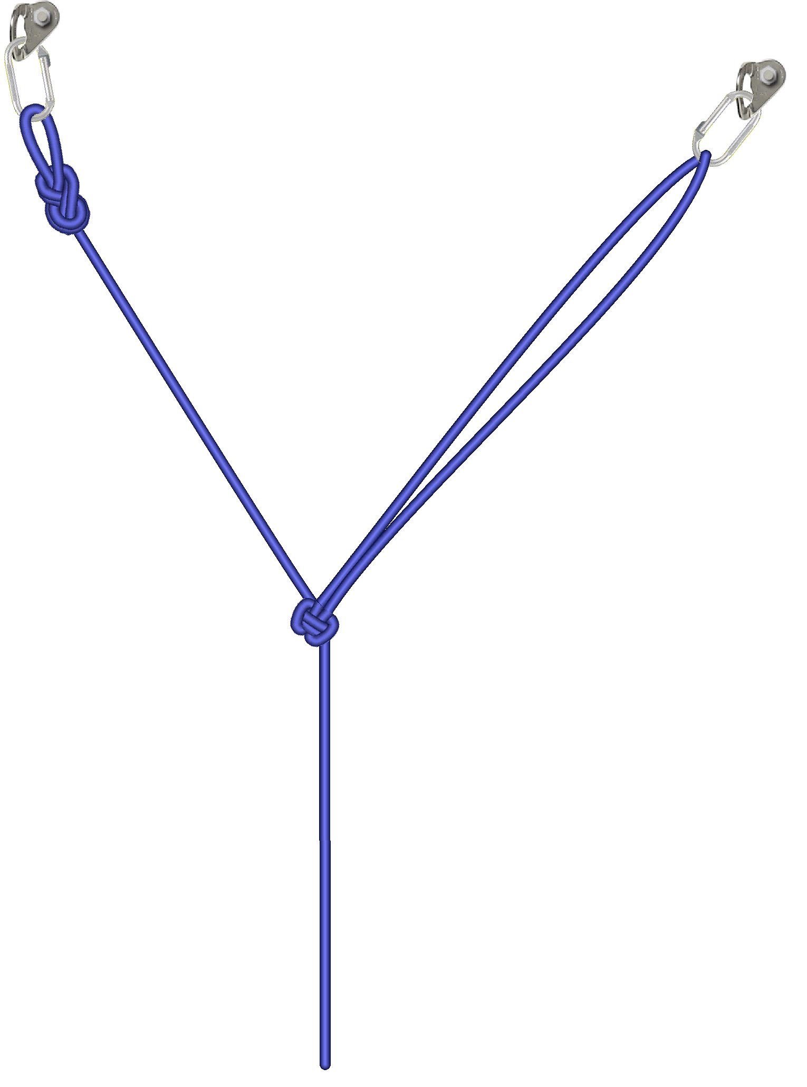
DAY 3 · ANCHORS — SEE IT
Y-Hang — Share the Load Between Two Anchors
BUILD IT
1
Two independent anchors, each rated
Either one alone must be able to hold the full load
2
Tie into the first anchor
Figure 8 on a bight, clipped with a locked connector
3
Run the second leg to the other anchor
Clip the bight; set leg length before you tie off
4
Tie the Y-hang knot at the center
Both legs share the load; knot dressed and set
5
Check the angle between the legs
Aim for 90° or less — never wider than 120°
At 120° each anchor carries 100% of the load. Wider than that, each anchor carries more than the load itself.
Illustration: vRigger
SKYTECH ACADEMY
SEE IT · Y-HANG
59
Notes:
Y-hang. Two anchors share the load through a central knot. Link back to the anchor-angle table: at 60° each leg carries ~58%, at 90° ~71%, at 120° 100%. The working rope and backup rope each get their own anchor system. Sources: SPRAT CRC-01 v25A §6.3. Illustration: vRigger — keep the credit and confirm usage rights.

Slide 58
INSTRUCTOR DISCUSSION
DAY 3
MBS, WLL / SWL & Equipment Limits
WHAT / HOW
WHY
WHEN / WHEN NOT
Read the right value
Why labels can be misread
Use approved limits
Differentiate minimum breaking strength from allowable working limits and manufacturer / system restrictions.
A breaking-strength number is not automatically an allowable operating load and does not replace system design.
Follow manufacturer, applicable standard, engineering and organizational procedures.
WHAT GOES WRONG
EVALUATOR'S EYE
TRAINEE Q&A
Universal division rules
Evaluator focus
“Can I calculate WLL from MBS myself?”
Do not teach “MBS ÷ 5” or “÷ 10” as a universal rope-access WLL formula.
Candidate knows when a rating can be used and when engineering / manufacturer data is required.
Not as a universal shortcut. Use the governing approved data / method for that equipment and system.
SKYTECH ACADEMY
DAY 3
60
Notes:
MBS versus working limits. MBS is the failure point — a reference, never an operating load. WLL is the safe working limit set by the manufacturer, standard or engineer. Teach trainees to read the governing value rather than apply a universal division rule; the safety factor depends on the component and the system, not a memorized fraction.
Sources: Manufacturer markings and instructions for use.

Slide 59
DAY 3 · LOAD PHYSICS REFERENCE
WLL vs. MBS — Breaking Point vs. Working Limit
MBS
WLL
EQUIPMENT
MBS
IN LBF ÷ FACTOR
EXAMPLE WLL
Minimum Breaking Strength — the failure point. Reference only.
Working Load Limit — the safe load you rig to.
Carabiner
27 kN
6,070 ÷ 5
1,214 lbf
Rope (with knot)
6,000 lbf
4,200* ÷ 10
420 lbf
HOW THE EXAMPLE IS CALCULATED
Example WLL = MBS ÷ design factor. This table uses metal ÷5 and textile / mechanical ÷10.
On the job, rig to the WLL the manufacturer states — factors vary by product.
Rigging plate
36 kN
8,093 ÷ 5
1,619 lbf
Pulley (body)
23 kN
5,170 ÷ 5
1,034 lbf
I’D descender
14 kN
3,147 ÷ 10
315 lbf
WLL assumes a static, in-line load. Shock loading and bad angles eat the margin fast.
1 kN = 224.8 lbf · * 6,000 lbf × 0.70 for knot loss (example)
System WLL = 315 lbf — the weakest link sets it.
SKYTECH ACADEMY
REFERENCE · WLL VS. MBS
61
Notes:
WLL vs MBS worked example. Convert each MBS to lbf (1 kN = 224.8 lbf), then divide by the example design factor: carabiner 27 kN = 6,070 lbf ÷ 5 = 1,214 lbf; rigging plate 36 kN = 8,093 ÷ 5 = 1,619; pulley 23 kN = 5,170 ÷ 5 = 1,034; rope 6,000 lbf × 0.70 knot loss = 4,200 ÷ 10 = 420; I’D 14 kN = 3,147 ÷ 10 = 315. The system WLL is the lowest value — 315 lbf. Stress that these factors are a teaching example; real WLLs come from the manufacturer and differ by product. Sources: manufacturer markings and instructions for use.
Sources: Manufacturer markings and instructions for use.

Slide 60
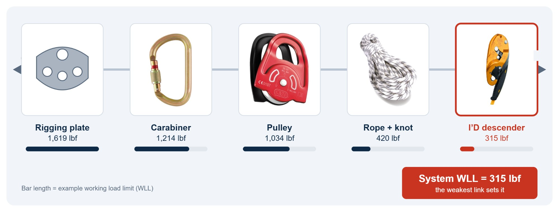
DAY 3 · LOAD PHYSICS — SEE IT
The Weakest Link Sets the System Rating
THE RULE
System WLL = the lowest WLL of any component in the load path.
THE TAKEAWAY
Upgrading a strong component changes nothing. Only the weakest one raises the rating.
SKYTECH ACADEMY
REFERENCE · WEAKEST LINK
62
Notes:
Weakest link. Using the previous slide’s example WLLs: plate 1,619, carabiner 1,214, pulley 1,034, rope with knot 420, I’D 315 lbf — the system is rated 315 lbf. Upgrading the plate changes nothing. Sources: manufacturer markings and instructions for use. Photos show each component; the rigging plate is a drawing — swap in a photo if available.

Slide 61
INSTRUCTOR DISCUSSION
DAY 3
Lowering & Hauling Systems
WHAT / HOW
WHY
WHEN / WHEN NOT
Control load movement
Why system efficiency matters
Choose the simplest safe system
Teach lowering devices, mechanical advantage, progress capture, redirects, backups, edge management and communication.
Friction, redirects and poor geometry change actual effort and forces — a theoretical haul ratio is not the real-world result.
Match the system to casualty / load, distance, obstacles, available rescuers and anchors.
WHAT GOES WRONG
EVALUATOR'S EYE
TRAINEE Q&A
Complexity without control
Evaluator focus
“Is a 4:1 always better than a 3:1?”
Too many components, poor progress capture, crossed ropes, overloaded redirects and unclear commands.
Correct rigging, backup, load control, communication and the ability to stop / hold safely.
No. More advantage adds rope travel, equipment and friction. Use what the scenario requires.
SKYTECH ACADEMY
DAY 3
63
Notes:
Lowering and hauling. Lower whenever the path is clear — gravity is reliable. Haul only when you must. Teach mechanical advantage with progress capture and backups, but stress that friction and redirects erode the theoretical ratio. More advantage is not
Sources: SPRAT Rope Access Certification Requirements (CRC-01, v25A, Jan 2025) §6.11, §7.7–7.9.

Slide 62
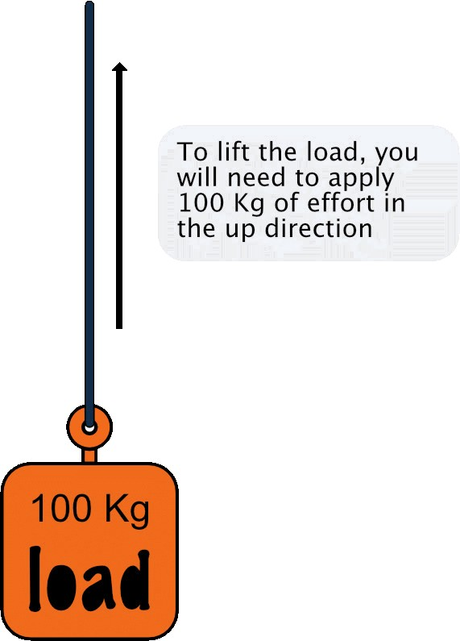
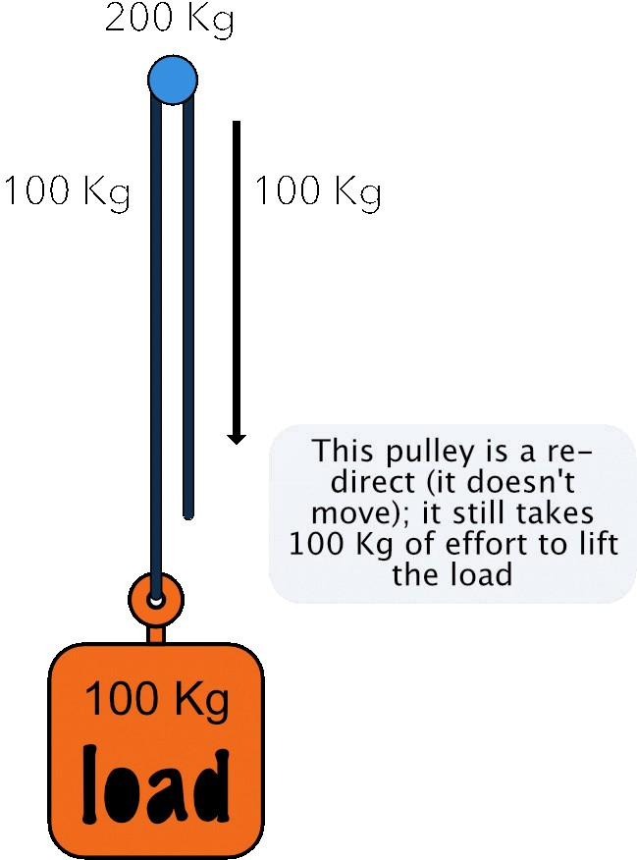
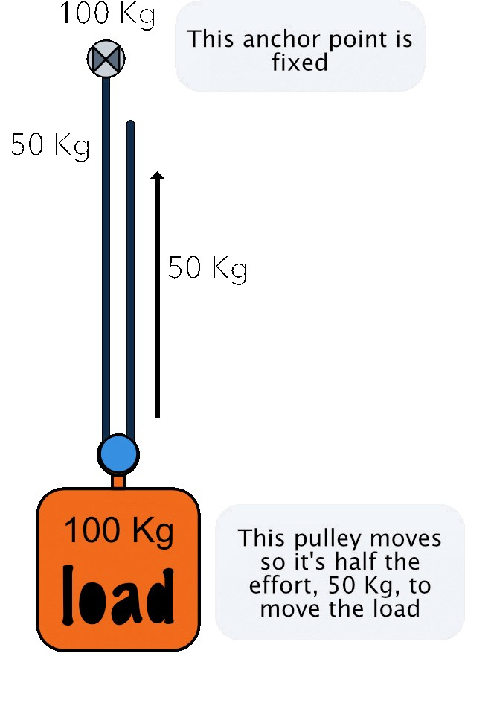
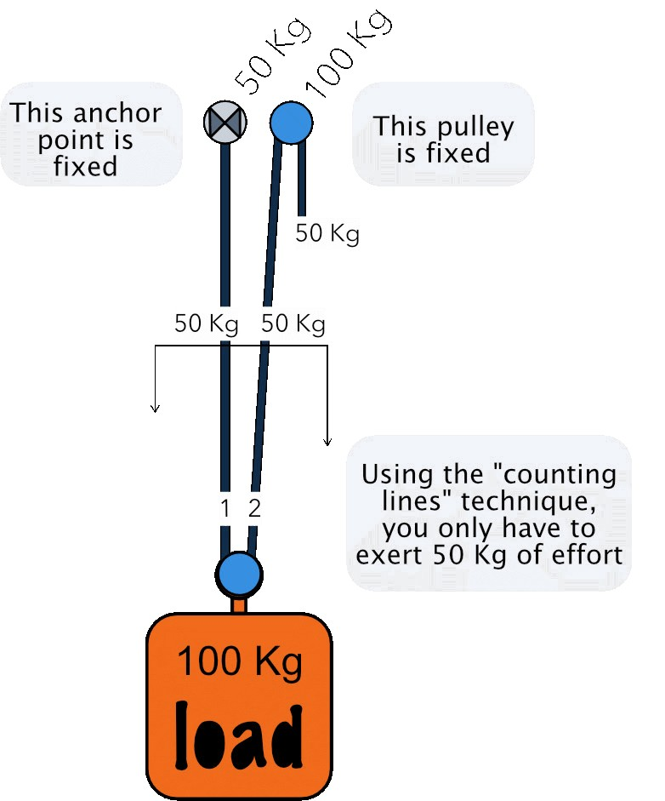
DAY 3 · HAULING — SEE IT
Mechanical Advantage — Count the Lines
1:1 · DIRECT LIFT
Effort = load
1:1 · REDIRECT
A fixed pulley only changes direction
2:1 · MOVING PULLEY
Pulley rides on the load
2:1 · COUNTING LINES
2 lines hold the load → 50 kg
Count the lines that hold the load. Two lines on a moving pulley = half the effort.
SKYTECH ACADEMY
HAULING · MA BASICS
65
Notes:
Mechanical advantage basics. A fixed pulley redirects but gives no advantage; a pulley that moves with the load does. Counting lines: count the rope segments that support the moving pulley or load. Figures ignore friction — real systems need more effort. Diagrams: supplied by SkyTech, recolored.

Slide 63
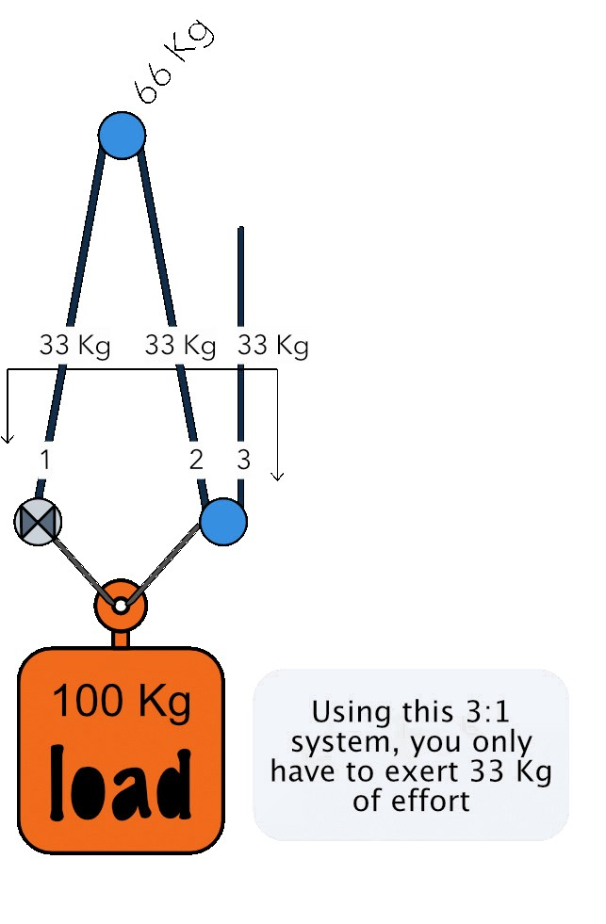
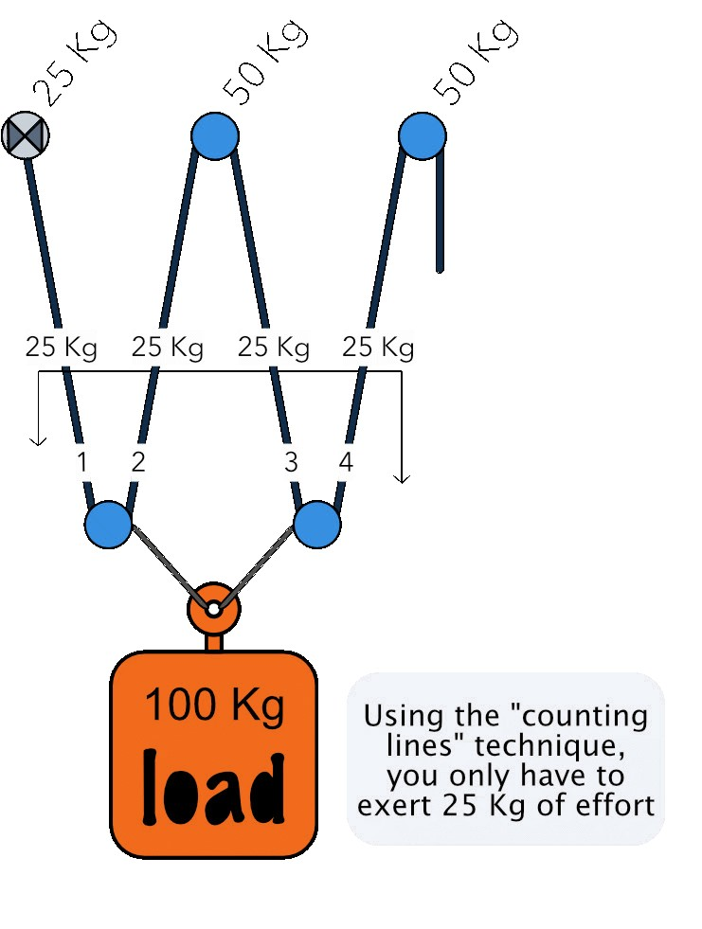
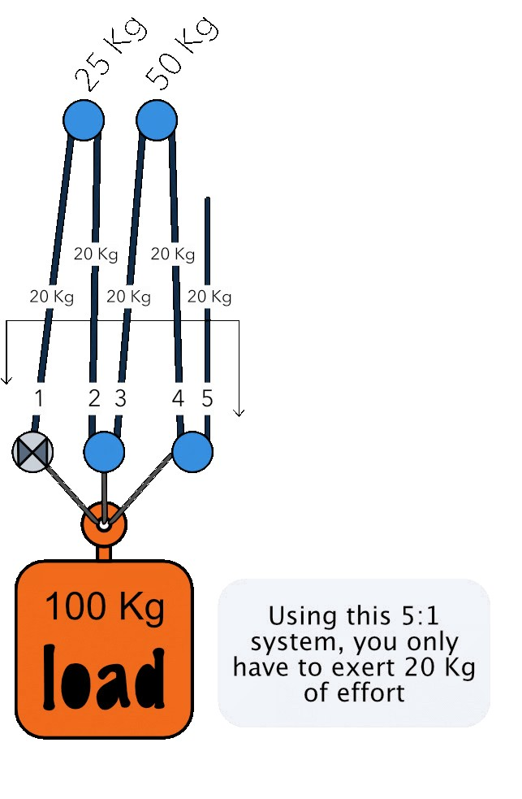
DAY 3 · HAULING — SEE IT
Simple Systems — 3:1, 4:1, 5:1
3:1
3 lines → 33 kg effort
4:1
4 lines → 25 kg effort
5:1
5 lines → 20 kg effort
Effort = load ÷ lines. Every pulley adds friction, so real effort is higher than the math.
SKYTECH ACADEMY
HAULING · SIMPLE SYSTEMS
66
Notes:
Simple systems. Effort = load ÷ number of supporting lines. Note the anchor loads: top pulleys carry two lines each. Ask trainees to count lines before revealing the effort. Friction ignored. Diagrams: supplied by SkyTech, recolored.

Slide 64

DAY 3 · HAULING — SEE IT
Building a Compound System — Step by Step
START WITH 2:1 · ADD A ROPE GRAB · ADD A SECOND SYSTEM ON THE GRAB
A rope grab on the haul line becomes the “load” for a second system — the ratios multiply.
SKYTECH ACADEMY
HAULING · COMPOUND BUILD
67
Notes:
Building a compound system. Start with a 2:1, attach a rope grab to the haul line, then rig a second system onto that grab. The second system pulls on the grab as if it were the load, so the ratios multiply. Diagrams: supplied by SkyTech, recolored.

Slide 65



DAY 3 · HAULING — SEE IT
Compound Systems — Multiply the Ratios
3:1 ON 2:1 = 6:1
1 unit in → 6 at the load
10:1 · T-METHOD
1 unit in → 10 at the load
10:1 · IN KG
10 kg effort → 100 kg load
3:1 on a 2:1 = 6:1. 5:1 on a 2:1 = 10:1. Higher ratio = less effort, more rope to pull and more friction.
SKYTECH ACADEMY
HAULING · COMPOUND SYSTEMS
68
Notes:
Compound systems. T-method: give the haul line 1 unit, add units at every pulley and rope grab, and read the total at the load. 3:1 on 2:1 gives 6 units (6:1). The tall diagram is 10:1 — 10 kg of effort lifts 100 kg, with anchor loads shown in kg. Friction ignored. Diagrams: supplied by SkyTech, recolored.

Slide 66
INSTRUCTOR DISCUSSION
DAY 3
Releasable Rigging & Edge Management
WHAT / HOW
WHY
WHEN / WHEN NOT
Rig with rescue in mind
Why pre-planning saves time
Use where the risk assessment supports it
Where appropriate, build systems that allow controlled lowering / transfer under load and protect ropes at edges.
A non-releasable system may force rescuers to build complex alternatives while a casualty remains suspended.
Consider work position, access, rescue direction, anchor capacity and edge conditions.
WHAT GOES WRONG
EVALUATOR'S EYE
TRAINEE Q&A
Unprotected edges / locked systems
Evaluator focus
“Should every rig be releasable?”
Abrasion, cutting, difficult casualty transfer and inability to lower a loaded system.
Rescue compatibility is considered during initial rigging — not added only after an incident.
Use the method the approved plan and conditions require; the key is that a workable rescue strategy exists.
SKYTECH ACADEMY
DAY 3
69
Notes:
Releasable rigging and edge management. Rig with rescue in mind — a locked-off system can force rescuers to build complex alternatives while a casualty hangs. Protect every edge from abrasion. The principle: rescue compatibility is designed in at rigging time, never bolted on after an incident.
Sources: SPRAT Rope Access Certification Requirements (CRC-01, v25A, Jan 2025) §4.3.3.

Slide 67

DAY 3 · RELEASABLE RIGGING — SEE IT
Rig for Rescue — Releasable Anchors and Protected Edges
THE PLAN
Rescue compatibility is built in at the start, not added after an incident.
THE EDGE
A protector at every edge contact; reroute or deviate the rope where you can.
SKYTECH ACADEMY
REFERENCE · RELEASABLE RIGGING
70
Notes:
Releasable anchor: the working line runs through a descender locked off at the anchor with a rope reserve, so a stuck technician can be lowered without cutting. Edge management: protector at every edge contact. Sources: SPRAT Rope Access Certification Requirements (CRC-01, v25A, Jan 2025) §4.3.3, §6.11.

Slide 68

DAY 3 · EDGE MANAGEMENT
Protecting the Rope — Work Down the List
1
IDENTIFY THE HAZARD
Walk the whole rope path. Look for sharp edges, hot surfaces, abrasion, chemicals, loose tools, wind, entanglement and entrapment.
WORK DOWN THE LIST
Try each step in order. Only move to the next step when the one above cannot remove the risk.
2
REMOVE IT
Grind or cover the sharp edge, shut off the heat source, clear anything the rope could snag on.
3
AVOID IT
Move the rope away from the hazard: alternative anchor, Y-hang, deviation or re-anchor.
SAFETY-CRITICAL
Fabric or canvas rope protectors guard against abrasion only. A sharp edge needs rigid edge protection — or re-rigging so the rope never touches it.
4
PROTECT AGAINST IT
Edge protector at edges, rope protector on other surfaces. Each rope gets its own protection.
5
VERIFY
Check the protection is right and secure. If it is not, do not go on rope.
SKYTECH ACADEMY
REFERENCE · ROPE PROTECTION
71
Notes:
Rope-protection hierarchy: identify, remove, avoid, protect, verify. Walk the rope path on the training structure and have each trainee name the hazard and the step that controls it. Stress that fabric protectors stop abrasion, not cutting.
Sources: SPRAT Rope Access Certification Requirements (CRC-01, v25A, Jan 2025) §4.3.3.

Slide 69

DAY 3 · EDGE MANAGEMENT — EXERCISE
Going Over the Edge — Protect the Rope at the Lip
SET-UP AND MOVE
1
Anchor back from the edge
Each rope on its own anchor, rigged before you approach
2
Protector at every contact point
Secured so it can’t slide off the lip
3
Backup rope protected too
Both ropes run over protection, not bare edge
4
Sit back, feet low, then step over
Weight in the harness before the feet leave the top
5
Check rope position below the lip
Rope runs clear; no new rub point
No bare rope over an edge. If you can’t protect it, re-route or deviate the rope.
SKYTECH ACADEMY
EXERCISE · EDGE TRANSITION
72
Notes:
Edge transition exercise. Trainees rig the anchors and protectors themselves, and the instructor checks every contact point before the first descent. Sources: SPRAT CRC-01 v25A §4.3.3, §6.11. Image: supplied by SkyTech — confirm usage rights.

Slide 70
INSTRUCTOR DISCUSSION
DAY 3
Rescue Fundamentals & Level 1 Progression
WHAT / HOW
WHY
WHEN / WHEN NOT
Make safe → access → stabilize → transfer → move → handover
Why rescue starts before the casualty
Simple, predictable scenarios first
The rescuer must not become a second casualty. Hazard control, redundancy and command come first.
Build competence before adding deviations, re-belays, transfers or complex hauling.
SPRAT L1 rescue: reach a casualty in ascent mode on an adjacent rope set, convert them to descent, move both onto one system and descend.
WHAT GOES WRONG
EVALUATOR'S EYE
TRAINEE Q&A
Rushing the casualty connection
Evaluator focus
“Do I rescue as fast as possible?”
Poor rescuer attachment, uncontrolled transfer, dropped backup, bad communication or uncontrolled descent.
Rescuer safety, casualty security, controlled transfer and correct final descent / landing.
Work promptly, but never sacrifice rescuer / casualty safety or system control for speed.
SKYTECH ACADEMY
DAY 3
73
Notes:
Rescue fundamentals. The sequence: make safe, access, stabilize, transfer, move, handover. Rescue starts before you reach the casualty — the rescuer must never become the second casualty. Build competence on simple pick-offs before layering in obstacles. Prompt, never rushed; control is everything.
Sources: SPRAT Rope Access Certification Requirements (CRC-01, v25A, Jan 2025) §6.12.

Slide 71

DAY 3 · RESCUE — EXERCISE
Rescue From Ascent Mode — Reach, Connect, Convert, Descend
SEQUENCE
1
Ascend to the casualty
Stop just below them; your own system stays complete
2
Connect the casualty to your harness
Short connection — keep them close
3
Take the casualty’s weight
Onto your descender, using a mini-haul if needed
4
Remove the casualty’s ascenders
Their backup stays on until they are on your system
5
Descend together under control
Brake hand on; backup managed for both
Rescuer safety first. Check your own system before you touch theirs.
SKYTECH ACADEMY
EXERCISE · RESCUE FROM ASCENT
74
Notes:
Rescue from ascent mode. Practice first at low height with a live casualty and a separate safety line. Have trainees describe each step before moving. Sources: SPRAT CRC-01 v25A §6.12. Image: supplied by SkyTech — confirm usage rights.

Slide 72
INSTRUCTOR DISCUSSION
DAY 3
Level 2 & 3 Rescue Through Obstacles
WHAT / HOW
WHY
WHEN / WHEN NOT
Move a casualty through system complexity
Why obstacles change rescue
Plan the entire route
L2: same-rope rescue with a rope-to-rope transfer, rescue from fall-arrest lanyards and a remote lowering system. L3: rescue from two maneuvers.
Two-person loads, limited mobility and device congestion make ordinary maneuvers significantly more complex.
Identify where load transfers, redirects and rescuer repositioning will occur before committing.
WHAT GOES WRONG
EVALUATOR'S EYE
TRAINEE Q&A
Solving one obstacle at a time without a plan
Evaluator focus
“What is the best rescue method?”
Can trap the rescuer / casualty, overload a system or create an impossible next step.
Planning, two-person load control, redundancy, obstacle sequence and efficient communication.
The simplest approved method that safely fits the casualty, geometry, hazards, equipment and team capability.
SKYTECH ACADEMY
DAY 3
76
Notes:
Rescue through obstacles. SPRAT L2 rescues: same rope set with a rope-to-rope transfer, rescue from energy-absorbing lanyards, and a remote rescue (lowering) system. L3 adds rescue from two maneuvers — deviation, knot pass, rope-to-rope transfer, re-anchor or aid climbing. Plan the whole route before committing; a two-person load behaves very differently.
Sources: SPRAT Rope Access Certification Requirements (CRC-01, v25A, Jan 2025) §7.10–7.12, §8.7.

Slide 73

DAY 3 · RESCUE — EXERCISE
Rescue From Descent Mode — Take Over the Casualty’s Load
SEQUENCE
1
Approach on your own system
Ascend or descend to just below the casualty
2
Connect the casualty to you
Short connection to your attachment point
3
Transfer their weight to your descender
Release their descender only after yours is loaded
4
Manage both backups
Casualty backup removed last
5
Descend together
Slow and controlled; hand over at the ground
The key step: a controlled transfer of the casualty’s weight onto the rescuer’s system.
SKYTECH ACADEMY
EXERCISE · RESCUE FROM DESCENT
77
Notes:
Rescue from descent mode. Contrast with ascent-mode rescue: the casualty’s descender must be released under load, so the transfer is the critical step. Sources: SPRAT CRC-01 v25A §7.10–7.12. Image: supplied by SkyTech — confirm usage rights.

Slide 74
SPRAT TASKS PRACTICED TODAY
L1 Build a two-rope system
L1 Raise & lower from the ground
L1 Pick-off rescue, adjacent ropes
L2 Remote rescue (lowering) system
L2 Rescue from fall-arrest lanyards
L2 Same-rope rescue + transfer
CLASSROOM → PRACTICAL
Day 3 Practical Training Plan
▸
Anchor identification and rigging exercises
▸
Angle / load demonstrations and system critique
▸
Lowering and hauling systems
▸
Releasable rigging / edge-management stations
▸
Level 1 rescue progression
▸
Level 2 obstacle-rescue progression
SKYTECH ACADEMY
DAY 3 · PRACTICAL
78
Notes:
Day 3 practical. Anchor and rigging exercises, then angle/load demonstrations trainees critique, then lowering and hauling, releasable rigging, and the Level 1 and Level 2 rescue progressions. Rescue dominates the afternoon.
Sources: SPRAT Rope Access Certification Requirements (CRC-01, v25A, Jan 2025) §6–7.
Discussion questions: Which anchor would you reject, and why? What did the angle demo change in your rigging? What slowed your rescue?
Image: the previous photo was removed because it showed non-industrial rescue (helicopter short-haul / park search and rescue). Replace with a SkyTech photo of rigging or rescue practice on your own training structure.

Slide 75

Notes:
Day start-off slide. Set the theme for the day and run the morning JSA before any practical activity.

Slide 76
DAY 4 · CLASSROOM
1–2 Hour Classroom — Advanced Skills, Rescue Scenarios & Consolidation
01
Advanced rigging & complex re-anchors
DISCUSS Is this the simplest system that works?
02
Horizontal / tensioned systems & aid climbing
DISCUSS What does tension do to the anchors?
03
Complex casualty movement
DISCUSS Who commands the load?
04
Level 3 rescue management
DISCUSS What is Plan B?
05
SPRAT level distinctions (L1 · L2 · L3)
DISCUSS What does each SPRAT level add?
06
Mock evaluation & targeted remediation
DISCUSS What did the mock reveal?
INSTRUCTOR NOTE
Today is where judgment matters more than technique. Emphasize simplicity, command and rescue foresight over adding components.
SKYTECH ACADEMY
DAY 4 · AGENDA
80
Notes:
Day 4 classroom agenda. The advanced day: complex rigging, horizontal and tensioned systems, complex casualty movement, Level 3 rescue command, SPRAT level distinctions, and a diagnostic mock evaluation. The theme is judgment under complexity — the simplest safe system wins.
Sources: SPRAT Rope Access Certification Requirements (CRC-01, v25A, Jan 2025) §7–8.

Slide 77
INSTRUCTOR DISCUSSION
DAY 4
Advanced Rigging & Complex Re-anchors
WHAT / HOW
WHY
WHEN / WHEN NOT
Design the route before loading it
Why planning dominates advanced work
Only within competence and approved design
Plan anchor layout, rope path, redundancy, rescue compatibility and transitions for more complex access.
Complex systems multiply the interaction between anchors, ropes, devices, edges and people.
Escalate engineered / high-load systems and unusual structures to the appropriate qualified authority.
WHAT GOES WRONG
EVALUATOR'S EYE
TRAINEE Q&A
Building complexity for its own sake
Evaluator focus
“What makes rigging ‘advanced’?”
Unnecessary redirects, inaccessible knots, poor rescue paths and unclear load distribution.
System simplicity, clean rigging, independence, load path and rescue foresight.
Not the number of components — the complexity of geometry, loading, access, rescue and supervision decisions.
SKYTECH ACADEMY
DAY 4
81
Notes:
Advanced rigging. Design the whole route before loading it — complex systems multiply the interactions between anchors, ropes, devices, edges and people. Advanced does not mean more components; it means harder geometry, loading and rescue decisions. Escalate engineered or high-load systems to a qualified authority.
Sources: SPRAT Rope Access Certification Requirements (CRC-01, v25A, Jan 2025) §8.4.

Slide 78

DAY 4 · AID CLIMBING — EXERCISE
Horizontal Aid Climbing — Two Connections at All Times
SEQUENCE
1
Clip the lead cowstail to the next anchor
Gate locked before any weight goes on
2
Clip the étrier and step up
Feet in the étrier, weight off the trailing cowstail
3
Clip the second cowstail forward
Now on two anchors again
4
Remove the trailing connection
Only once both forward connections are loaded
5
Repeat, anchor by anchor
SPRAT L1: 3 m horizontal · L2: 3 m vertical or angled
Swing fall ≤ 2 ft. Plan anchor spacing so a slip cannot swing you into the structure.
SKYTECH ACADEMY
EXERCISE · AID CLIMBING
83
Notes:
Aid climbing exercise. SPRAT Level 1 aid-climbs 3 m horizontally; Level 2 aid-climbs 3 m vertically or at an angle. Keep two connections at all times. Sources: SPRAT CRC-01 v25A §6.8, §7.4, §4.2.5. Image: supplied by SkyTech — confirm usage rights.

Slide 79
INSTRUCTOR DISCUSSION
DAY 4
Horizontal / Tensioned Systems & Aid Climbing
WHAT / HOW
WHY
WHEN / WHEN NOT
Maintain continuous protection while moving laterally
Why lateral movement changes risk
Use approved system design
Anchors may see different directions and forces, and the worker can experience larger swings or difficult rescue access.
Tensioned systems require careful force management — do not improvise high-tension rigging.
SPRAT progression: L1 aid-climbs 3 m horizontally, L2 aid-climbs 3 m vertically or at an angle, L3 builds and uses a tensioned rope system.
WHAT GOES WRONG
EVALUATOR'S EYE
TRAINEE Q&A
Over-tensioning and poor backup
Evaluator focus
“Can I pull the line tighter to reduce sag?”
High anchor forces, insufficient redundancy, long fall / swing paths and difficult casualty recovery.
Controlled progression, connection sequence, system-force awareness and a rescue plan.
Increasing tension can greatly increase anchor / system forces. Follow the approved design and limits.
SKYTECH ACADEMY
DAY 4
82
Notes:
Horizontal and tensioned systems and aid climbing. Lateral movement changes the direction and magnitude of anchor forces and creates larger swing paths. The critical warning: tensioning a line to remove sag can multiply anchor forces dramatically — never improvise high-tension rigging; follow the approved design.
Sources: SPRAT Rope Access Certification Requirements (CRC-01, v25A, Jan 2025) §6.8, §7.4, §8.6.

Slide 80

DAY 4 · TENSIONED LINES — SEE IT
Tensioned Lines — Less Sag, Much Higher Anchor Force
Photo: Masa Sakano · CC BY-SA 2.0 · Wikimedia Commons
THE PHYSICS
Anchor force = load ÷ (2 × sin of the sag angle).
THE RULE
Follow the approved design; never over-tension a line to reduce sag.
SKYTECH ACADEMY
REFERENCE · TENSIONED LINES
84
Notes:
Tensioned lines. Anchor force = load ÷ (2 × sin sag angle): 30° → 1.0×, 15° → 1.9×, 5° → 5.7× the load at each anchor. Next slide works the numbers. Sources: SPRAT Rope Access Certification Requirements (CRC-01, v25A, Jan 2025) §8.6.

Slide 81
DAY 4 · TENSIONED LINES — DO THE MATH
Tensioned Lines — Anchor Force by Sag Angle
SAG ANGLE
MULTIPLIER
1 PERSON · 220 LB
RESCUE · 440 LB
DO THE MATH
30°
1.00 ×
220 lbf
440 lbf
Two-person rescue load, 10° sag
15°
1.93 ×
425 lbf
850 lbf
sin 10°
= 0.174
2 × 0.174
= 0.347
10°
2.88 ×
633 lbf
1,267 lbf
440 lb ÷ 0.347
= 1,267 lbf
5°
5.74 ×
1,262 lbf
2,524 lbf
at each anchor — nearly 3× the load.
Force at EACH anchor = load ÷ (2 × sin sag angle). Example loads; real loads are dynamic.
THE RULE
Rig to the approved design and its anchor ratings. Never over-tension a line to reduce sag.
Halve the sag angle and the anchor force roughly doubles. A tight line can load each anchor with several times the rescue load.
SKYTECH ACADEMY
REFERENCE · TENSIONED-LINE FORCES
85
Notes:
Worked example. 220 lb at 30°, 15°, 10°, 5° sag = 220, 425, 633, 1,262 lbf per anchor; a 440 lb two-person rescue load doubles each figure. Show the 10° calculation on the board: sin 10° = 0.174, × 2 = 0.347, 440 ÷ 0.347 = 1,267 lbf. Static values — dynamic loading is higher. Sources: SPRAT Rope Access Certification Requirements (CRC-01, v25A, Jan 2025) §8.6; force = load ÷ (2 × sin θ).

Slide 82

DAY 4 · TENSIONED LINES — EXERCISE
Tensioned-Line Traverse — Rig It, Ride It, Check It
SET-UP
1
Two lines, each with its own anchors
A failure of one line must not drop the technician
2
Anchors rated for tension forces
Use the sag-angle math from the previous slide
3
Connect to both lines
Pulleys or connectors on each line, cowstails locked
4
Control the travel
Haul or tag line to move; never free-wheel
5
Check sag under load
Confirm the angle matches the approved design
Never over-tension a line to reduce sag — anchor force rises fast.
SKYTECH ACADEMY
EXERCISE · TENSIONED LINE
86
Notes:
Tensioned-line exercise, a SPRAT Level 3 skill. Have trainees estimate sag angle under load and calculate anchor force before anyone gets on the line. Sources: SPRAT CRC-01 v25A §8.6. Image: supplied by SkyTech — confirm usage rights.

Slide 83
INSTRUCTOR DISCUSSION
DAY 4
Complex Casualty Movement
WHAT / HOW
WHY
WHEN / WHEN NOT
Control two-person systems through obstacles
Why small errors become large
Use staged checkpoints
Coordinate rescuer position, casualty orientation, load transfer, hauling / lowering and edge / obstacle passage.
Casualty weight, device congestion and limited mobility reduce the margin for improvisation.
Pause in stable positions before each major transfer or obstacle.
WHAT GOES WRONG
EVALUATOR'S EYE
TRAINEE Q&A
Unplanned simultaneous actions
Evaluator focus
“Who should move first?”
Multiple rescuers moving devices or loads without one command can create shock loads or loss of control.
Stable staging, clear commands, controlled load transfer and casualty protection.
The rescue plan and command structure decide; only one coordinated plan should control the load.
SKYTECH ACADEMY
DAY 4
87
Notes:
Complex casualty movement. Two-person loads through obstacles leave little margin — coordinate rescuer position, casualty orientation and every transfer. Use staged checkpoints: pause in stable positions before each obstacle. The danger is unplanned simultaneous action; one command controls the load.
Sources: SPRAT Rope Access Certification Requirements (CRC-01, v25A, Jan 2025) §7.11, §8.7.

Slide 84

DAY 4 · CASUALTY MOVEMENT — SEE IT
Cross-Haul — Move the Casualty Away From the Structure
HOW IT WORKS
1
Two haul systems from separate overhead anchors
Each side has its own main line and backup line
2
Casualty hangs from a rigging plate
Lines from both sides meet at the plate above the casualty
3
Haul one side, lower the other
Shifting the balance moves the casualty sideways
4
Progress capture on every haul line
A release of the hand never drops the load
5
One leader gives every command
Both teams move only on the leader’s call
Watch the angles. A flat V between the two sides multiplies anchor loads — the same physics as the Y-hang.
SKYTECH ACADEMY
SEE IT · CROSS-HAUL
88
Notes:
Cross-haul, a Level 3 complex casualty-movement technique. Two opposed hauling systems suspend the casualty from a central rigging plate; hauling one side while lowering the other moves the casualty horizontally to clear obstructions. Every line has progress capture and a backup. One person leads and calls each move. Sources: SPRAT CRC-01 v25A §8.10 (complex rescue). Image: supplied by SkyTech — confirm usage rights.

Slide 85
INSTRUCTOR DISCUSSION
DAY 4
Level 3 Rescue Management
WHAT / HOW
WHY
WHEN / WHEN NOT
Size up, command, plan, execute, terminate
Why leadership is a technical skill
Use closed-loop communication
Assign roles, select Plan A / Plan B, and manage communications, resources, fatigue and the medical interface.
A correct rope system can still fail operationally if commands, roles or contingency planning are weak.
One rescue lead; commands are repeated and confirmed before any load movement.
WHAT GOES WRONG
EVALUATOR'S EYE
TRAINEE Q&A
Everyone solving independently
Evaluator focus
“Should the Level 3 do every rope task?”
Conflicting commands, duplicated actions, equipment confusion and no shared fallback plan.
Leadership, hazard control, method selection, communication and adaptation without losing system safety.
No. The supervisor manages the operation and delegates while maintaining control and oversight.
SKYTECH ACADEMY
DAY 4
89
Notes:
Level 3 rescue management. Leadership is a technical skill: size up, command, plan A and B, execute, terminate. One rescue lead, closed-loop communication, commands confirmed before load movement. A perfect rope system still fails if command is weak. The supervisor manages and delegates — they do not do every task themselves.
Sources: SPRAT Safe Practices for Rope Access Work.

Slide 86
INSTRUCTOR DISCUSSION
DAY 4
SPRAT Level Distinctions
WHAT / HOW
WHY
WHEN / WHEN NOT
Teach the current SPRAT documents — not a blended homemade version
Why the distinction matters
Verify before every course cycle
Each SPRAT level carries its own responsibilities, experience requirements and evaluation criteria. Mixing them creates incorrect expectations or eligibility advice.
Use current official certification / training requirements with documented revision control.
Keep certification levels, experience / upgrade requirements, evaluation methods and terminology tied to the applicable official documents.
WHAT GOES WRONG
EVALUATOR'S EYE
TRAINEE Q&A
Outdated hour / month claims
Evaluator focus
“Can I skip straight to Level 2 or 3?”
Do not rely on simplified remembered upgrade rules when the official scheme document controls.
Instructor materials match the candidate’s actual SPRAT level.
No. Each level has its own experience and evaluation requirements under current SPRAT rules.
SKYTECH ACADEMY
DAY 4
90
Notes:
SPRAT level distinctions. L1: ascent/descent and changeovers, edge with rope protection, ~20° deviation, knot pass, rope-to-rope transfer, re-anchor, 3 m horizontal aid climb, four knot functions, a simple two-rope system, raise/lower from the ground and an adjacent-rope pick-off rescue. L2 adds system analysis, vertical aid climbing, edge rigging on anchors 1–4 m apart, a retrievable system, raising/lowering while suspended, lowering a suspended load, cross-haul, a remote rescue system, same-rope rescue with transfer and rescue from fall-arrest lanyards. L3 adds rigging a deviation or re-anchor, raise/lower through a knot pass, a tensioned rope system and rescue from two maneuvers. Upgrades: 500 hours and 6 months at the current level.
Sources: SPRAT Rope Access Certification Requirements (CRC-01, v25A, Jan 2025) §3.3, §6–8.

Slide 87

DAY 4 · SPRAT LEVELS — SEE IT
SPRAT Levels — Who Does What on the Rope
THE STRUCTURE
Level 1 and Level 2 technicians work under a Level 3 supervisor.
THE SOURCE
Experience and upgrade requirements come from the current SPRAT documents only.
SKYTECH ACADEMY
REFERENCE · SPRAT LEVELS
91
Notes:
SPRAT levels on the rope. L1 works under L3 supervision and performs a pick-off rescue; L2 rigs, hauls and performs rescues under L3 supervision; L3 supervises the worksite, the rescue plan and system checks. Sources: SPRAT Rope Access Certification Requirements (CRC-01, v25A, Jan 2025) §3.

Slide 88
INSTRUCTOR DISCUSSION
DAY 4
Mock Evaluation & Targeted Remediation
WHAT / HOW
WHY
WHEN / WHEN NOT
Simulate independent performance
Why the mock helps
Use it as a diagnostic
Run equipment / theory, maneuver, rigging, rescue and scenario stations appropriate to the candidate level.
It reveals whether the trainee can perform without step-by-step instructor prompting.
Identify specific gaps and remediate them safely before final assessment.
WHAT GOES WRONG
EVALUATOR'S EYE
TRAINEE Q&A
Turning the mock into nonstop coaching
Evaluator focus
“What should I practice tonight?”
If the instructor supplies every next step, the exercise no longer tests independent competence.
Safety, sequence, judgment, self-checking and recovery from minor errors within SPRAT rules.
Focus on identified weak areas, review theory, and rest. Fatigue is not a training strategy.
SKYTECH ACADEMY
DAY 4
92
Notes:
Mock evaluation. Simulate real assessment conditions — no step-by-step prompting — to diagnose who can perform independently. Resist the urge to coach through it; that hides the gaps. Use the results to target remediation, then send trainees to rest. Fatigue is not a training strategy.
Sources: SPRAT Rope Access Certification Requirements (CRC-01, v25A, Jan 2025) §5.

Slide 89
SPRAT TASKS PRACTICED TODAY
L2 Cross-haul (lateral operations)
L2 Retrievable two-rope system
L2 Vertical aid climbing
L3 Tensioned rope system
L3 Rig a deviation or re-anchor
L3 Rescue from two maneuvers
CLASSROOM → PRACTICAL
Day 4 Practical Training Plan
▸
Advanced rigging / complex re-anchor exercises
▸
Horizontal / tensioned-system or aid-climbing drills as applicable
▸
Complex casualty movement
▸
Team rescue scenario with assigned command roles
▸
Plan A / Plan B scenario changes
▸
Mock evaluation + targeted remediation
SKYTECH ACADEMY
DAY 4 · PRACTICAL
94
Notes:
Day 4 practical. Advanced rigging, lateral-system drills, complex casualty movement, then a team rescue scenario with assigned command roles and a mid-scenario Plan A to Plan B change. Close with the mock evaluation and targeted remediation.
Sources: SPRAT Rope Access Certification Requirements (CRC-01, v25A, Jan 2025) §7–8.
Discussion questions: What made the scenario hard — technique or command? When did Plan B start? What will you practice tonight?
Image: the previous photo was removed because it showed non-industrial rescue (helicopter short-haul / park search and rescue). Replace with a SkyTech photo of rigging or rescue practice on your own training structure.

Slide 90

Notes:
Day 5 start-off slide — assessment, debrief and professional development. Frame the day: independent assessment, then a debrief and a clear development path.

Slide 91
DAY 5 · CLASSROOM
Assessment Day — Briefing, Written Test & Practical Evaluation
01
Assessment-day orientation
DISCUSS What happens today, in order?
02
Eligibility & documents
DISCUSS ID, affidavit, logbook — who has what?
03
Written test
DISCUSS Read every question twice
04
Practical evaluation
DISCUSS Plan, verify, move, re-verify
05
Grading & provisional results
DISCUSS How are P, D and F given?
06
Debrief & logbook closeout
DISCUSS What gets logged before you leave?
INSTRUCTOR NOTE
The evaluator runs the day. Instructors brief, check documents and step back — no coaching once the evaluation starts.
SKYTECH ACADEMY
DAY 5 · AGENDA
96
Notes:
Day 5 classroom agenda: the assessment day. Brief the order of the day, check every candidate’s ID, signed affidavit and (for upgrades) logbook, then hand over to the independent evaluator for the written test and practical evaluation. Instructors do not coach once the evaluation starts.
Sources: SPRAT Rope Access Certification Requirements (CRC-01, v25A, Jan 2025) §2.1–2.2, §3.1, §5.

Slide 92
INSTRUCTOR DISCUSSION
DAY 5
Assessment-Day Orientation
WHAT / HOW
WHY
WHEN / WHEN NOT
Assessment is independent evaluation
Why training and assessment are separated
Use the SPRAT process
Verify eligibility and documents, explain assessment boundaries and let the assessor run the process per SPRAT requirements.
Competence must be demonstrated without the instructor feeding the candidate each step.
Every candidate takes a written test and a practical evaluation set for their SPRAT level.
WHAT GOES WRONG
EVALUATOR'S EYE
TRAINEE Q&A
Last-minute coaching during assessment
Evaluator focus
“Can my instructor help if I get stuck?”
Prompting can compromise the independence and validity of the evaluation.
Candidate arrives prepared, understands the rules and demonstrates their own competence.
During formal independent assessment, follow the evaluator’s rules; do not expect coaching as in training.
SKYTECH ACADEMY
DAY 5
97
Notes:
Assessment-day orientation. Assessment is independent evaluation by an assessor — not the instructor. Verify eligibility and documents, explain the boundaries, then step back. The separation of training and assessment is what makes the credential mean something; last-minute coaching compromises its validity.
Sources: SPRAT Rope Access Certification Requirements (CRC-01, v25A, Jan 2025) §2.1–2.2, §3.1.

Slide 93
INSTRUCTOR DISCUSSION
DAY 5
Theory & Verbal Knowledge
WHAT / HOW
WHY
WHEN / WHEN NOT
Explain — not just recite
Why verbal reasoning matters
Answer within your competence
Candidates understand equipment, hazards, standards / SPRAT concepts, rigging, rescue and role responsibilities appropriate to their level.
Safe rope access requires decisions when the exact training setup is not present.
Know when the correct answer is to stop and escalate.
WHAT GOES WRONG
EVALUATOR'S EYE
TRAINEE Q&A
Guessing technical limits
Evaluator focus
“What if I don’t remember a number?”
Inventing ratings, anchor capacities or requirements is worse than recognizing that authoritative information is needed.
Accurate knowledge, sound reasoning and recognition of limits.
Do not invent it. Explain where you would verify the controlling requirement.
SKYTECH ACADEMY
DAY 5
98
Notes:
Theory and verbal knowledge. The standard is explain, not recite — safe work requires judgment when the exact training rig is not in front of you. The professional answer to a number you do not recall is never to invent it, but to say where you would verify the controlling requirement. Knowing your limits is graded.
Sources: SPRAT Rope Access Certification Requirements (CRC-01, v25A, Jan 2025) §2.1.1.

Slide 94
INSTRUCTOR DISCUSSION
DAY 5
Practical Assessment Behavior
WHAT / HOW
WHY
WHEN / WHEN NOT
Plan → verify → move → re-verify
Why safety overrides speed
Pause when needed
Use deliberate sequencing, connection checks, controlled movement and continuous redundancy.
Fast completion has no value if the system becomes uncontrolled or unsafe.
A deliberate safe pause to assess the next step beats rushing into a dangerous sequence.
WHAT GOES WRONG
EVALUATOR'S EYE
TRAINEE Q&A
Panic after a small error
Evaluator focus
“Should I restart if I make a mistake?”
Candidates compound a minor issue by moving faster or disconnecting the wrong component.
Independent safe performance, correct technique, judgment and self-correction within SPRAT criteria.
Follow the evaluator’s instructions. The priority is to stay safe and avoid compounding the error.
SKYTECH ACADEMY
DAY 5
99
Notes:
Practical assessment behavior. The rhythm is plan, verify, move, re-verify. Slow is smooth — a deliberate pause to assess beats rushing into danger. The most common failure is panic after a small error, compounding it. Calm self-correction within the scheme rules is exactly what the evaluator is credited to see.
Sources: SPRAT Rope Access Certification Requirements (CRC-01, v25A, Jan 2025) §4, §5.

Slide 95
INSTRUCTOR DISCUSSION
DAY 5
Results, Debrief & Remediation
WHAT / HOW
WHY
WHEN / WHEN NOT
Turn the outcome into a development plan
Why the debrief matters
Document accurately
Review the result, feedback, strengths, gaps and any SPRAT next steps.
Passing is not mastery of every future scenario; an unsuccessful assessment should produce a focused improvement plan.
Maintain training / assessment records and any required logbook entries.
WHAT GOES WRONG
EVALUATOR'S EYE
TRAINEE Q&A
Treating certification as the finish line
Evaluator focus
“If I pass, can I supervise immediately?”
Skills decay, and work environments introduce hazards not seen in training.
Professional response to feedback and a clear understanding of limitations and next steps.
Only within the authority of your certification level, employer / site requirements and demonstrated competence.
SKYTECH ACADEMY
DAY 5
100
Notes:
Results and debrief. Turn the outcome into a development plan — pass or not. Certification is a licence to keep learning, not a finish line; skills decay and real sites present hazards training cannot. A pass does not mean instant supervision — that is bounded by your level, the employer and demonstrated competence.
Sources: SPRAT Rope Access Certification Requirements (CRC-01, v25A, Jan 2025) §2.2.4–2.2.5, §9.

Slide 96

CLASSROOM → PRACTICAL
Day 5 Practical Training Plan
▸
Eligibility / equipment check and briefing
▸
Theory / verbal knowledge assessment
▸
Practical maneuvers by candidate level
▸
Rigging and rescue assessment by candidate level
▸
Results and debrief
▸
Logbook / recertification / development closeout
Photo: Christian Thiel · CC BY-SA 4.0 · Wikimedia Commons
SKYTECH ACADEMY
DAY 5 · PRACTICAL
101
Notes:
Day 5 practical is the assessment itself: eligibility and equipment check, theory and verbal knowledge, practical maneuvers and rescue by candidate level, then results, debrief and the logbook and development closeout.
Sources: SPRAT Rope Access Certification Requirements (CRC-01, v25A, Jan 2025) §2.
Discussion questions: What did your result tell you? What goes in your logbook today? What does your next level require?

Slide 97
INSTRUCTOR APPENDIX
What to Expect From Your Instructor
1 · Explain
2 · Demonstrate
3 · Coach
Use the six teaching boxes on every lesson: what / how, why, when / when-not, failure modes, evaluator focus and trainee Q&A.
Show the complete technique once, then break it into decision points and safety checks.
Correct unsafe sequence immediately; use questions so trainees explain the reason for the correction.
4 · Repeat
5 · Evaluate
6 · Document
Progress from assisted practice to independent repetition without sacrificing redundancy or control.
Observe the whole process — planning, setup, movement, self-checking, communication and recovery — not just the final position.
Record attendance, JSA participation, skill progression, remediation and readiness for assessment.
SKYTECH ACADEMY
INSTRUCTOR APPENDIX
102
Notes:
This appendix is the instructor method that runs under every lesson: explain using the six teaching boxes, demonstrate the whole technique then break it into decision points, coach by correcting unsafe sequence immediately and asking trainees to explain the fix, repeat from assisted to independent without losing redundancy, evaluate the whole process not just the final position, and document participation and progression. Hold every instructor to this method so the course is consistent regardless of who delivers it.
Sources: SkyTech instructor method.

Slide 98
INSTRUCTOR APPENDIX
Document & Standards Verification Before Each Course
✓
Verify the current SPRAT syllabus and certification documents applicable to the candidates being trained.
✓
Verify applicable OSHA requirements for the actual work environment — do not present scheme guidance as a substitute for law.
✓
Verify manufacturer instructions for every harness, connector, rope, descender, ascender, backup device, pulley and rescue component.
✓
Confirm training structures, anchors and engineered systems are approved for the intended loads and exercises.
✓
Update lesson plans when official scheme documents, standards, manufacturer instructions or equipment change.
✓
Maintain a revision number, effective date, reviewer / approver and list of controlling documents for this instructor edition.
SOURCE NOTE
SPRAT content checked against Rope Access Certification Requirements CRC-01, v25A (January 2025). Re-verify at sprat.org before each course cycle.
SKYTECH ACADEMY
INSTRUCTOR APPENDIX
103
Notes:
Before every course cycle, verify the controlling documents: the current SPRAT syllabus for the candidates, the applicable OSHA requirements for the actual work environment, and the manufacturer instructions for every item of equipment. Confirm training structures and engineered systems are approved for the intended loads. Update lesson plans whenever official documents, standards, manufacturer instructions or equipment change, and keep revision control on this instructor edition. The source note is important for accreditation: this deck is organized from SkyTech's supplied material, and technical details must be verified against current official sources before formal delivery.
Sources: SPRAT Rope Access Certification Requirements (CRC-01, v25A, Jan 2025); OSHA 29 CFR 1910.140 / 1926 Subpart M; manufacturer instructions.

Slide 99

Notes:
Close the course by returning to the three principles that underwrite every technique: redundancy, continuous protection, controlled movement — plus rescue readiness. The professional identity to leave them with: train the technician to understand the system, not merely memorize the maneuver. That is what makes a safe, employable, promotable rope access professional. Contact details are on screen for recertification, upgrades and employer placement support.

